Slide 1
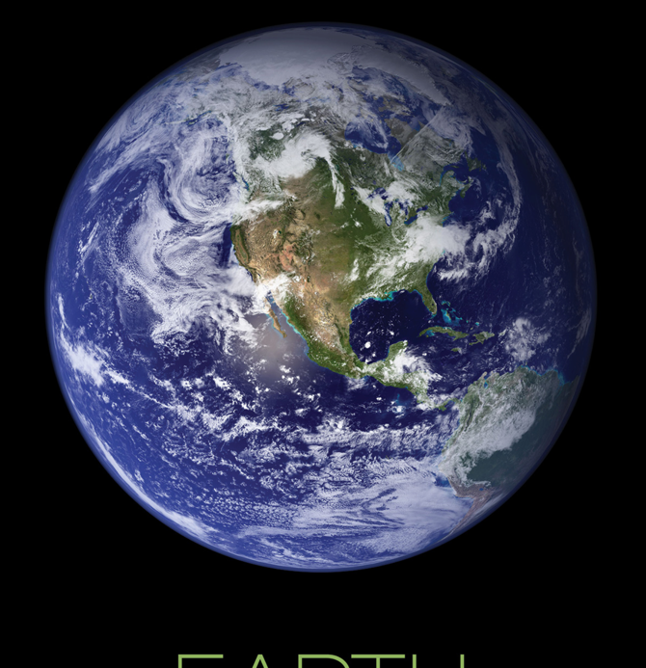



Earth’s Sun and Moon
Observe the Moon
Investigate the Moon
Background information
Daisy and Brownie - Sun & Moon
GSUSA marks and content used with permission of the Girl Scouts of the USA
Notes:
https://solarsystem.nasa.gov/resources/991/earth-poster-version-a/
Slides support Daisy (Observe the Moon) and Brownie (Investigate the Moon) Space Science badge steps

Slide 2
Sun, Moon & Earth facts, images, and more
Online Resources
NASA SpacePlace - Sun
Girl Scouts Sun fact sheet
NASA Pictures of the Sun - today!
NASA Posters: Sun, Moon, Earth
NASA SpacePlace - Moon (K-5)
Girl Scouts Moon fact sheet
NASA Moon
NASA’s Dial a Moon
Moonrise time www.timeanddate.com/moon/

Slide 3
Sun, Moon & Earth activities and more
Online Resources
Activities
Moon Sky Book GS at Home video (Daisy Step)
Model the Moon (Brownie Step)
Make Moon Art GS at Home video (Brownie Step)
Sun, Earth, Moon and Eclipses Activity Guide PDF
NASA Sun activities
Make Sun Cookies PDF
Moon Phase Cup
Books
Moonbear’s Shadow & Happy Birthday, Moonbear
Moon Stories (Free PDF by ASP)
Breakfast Moon (story ASP store)
Counting on Katherine (women in science)
Margaret and the Moon by Dean Robbins (women in science)
Songs
Moon phases song PDF Lunar & Planetary Society
Earth & Moon Songs(.doc)
International Observe the Moon Night song ideas

Slide 4






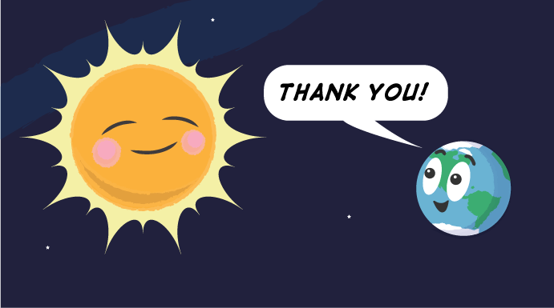
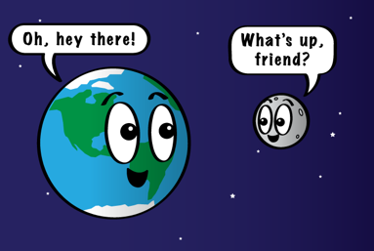

Illustrations
Notes:
https://spaceplace.nasa.gov/review/moon-distance/moondistance-03.en.png
https://spaceplace.nasa.gov/templates/featured/earth/earth300.png
https://spaceplace.nasa.gov/all-about-earth/en/
https://spaceplace.nasa.gov/stained-glass-earth/en/

Slide 5
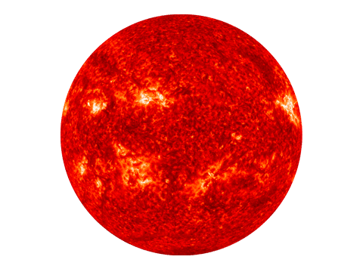
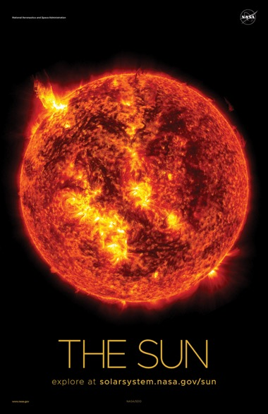
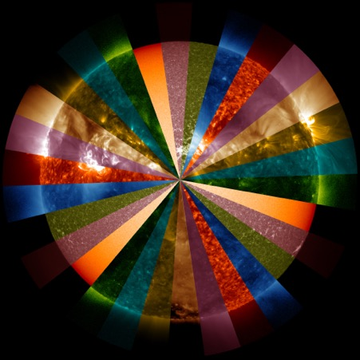
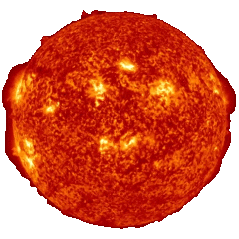
Images
Notes:
https://solarsystem.nasa.gov/system/resources/detail_files/980_poster_sun_front_a.jpg
https://nineplanets.org/planets-transparent-background/
https://giphy.com/gifs/nasa-nasagif-iBcLO98TliQ0njHGb7
https://solarsystem.nasa.gov/system/resources/detail_files/698_SlicesOfSDO_rotor_stand.4Kx4K.03000.jpg
For more, visit https://spaceplace.nasa.gov/gallery-sun/en/

Slide 6
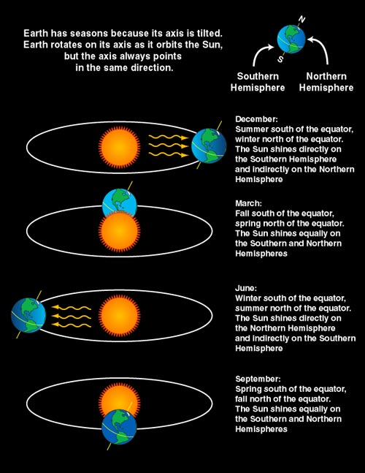
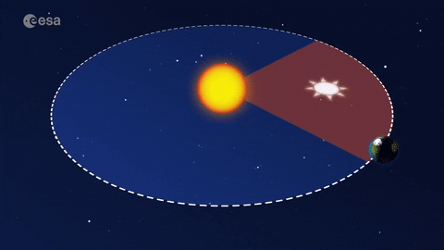
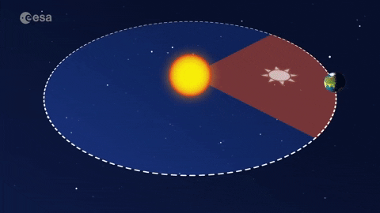
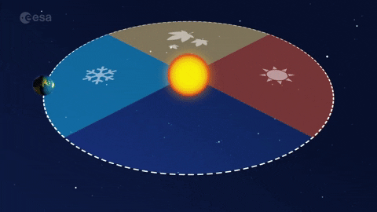

Images – Seasons
Notes:
Junior Space Science badge step - seasons
https://spaceplace.nasa.gov/seasons/en/seasons.en.jpg
https://giphy.com/explore/paxi
https://media2.giphy.com/media/9x1baN5IeSL7L5CChF/giphy.gif?cid=5e214886p5gm0n7bbx6c37gnrfag2p3mgsbryqrohiov4y88&rid=giphy.gif&ct=g

Slide 7
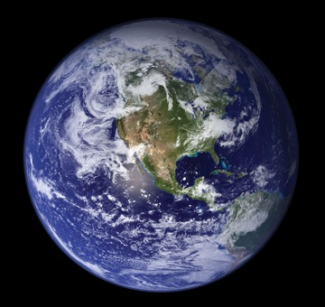
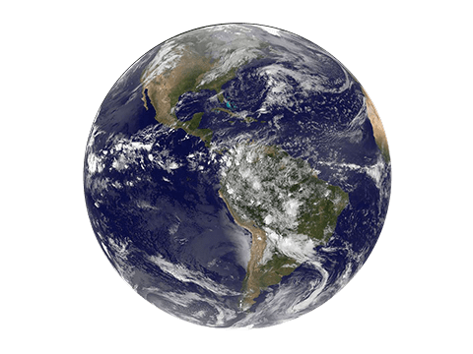
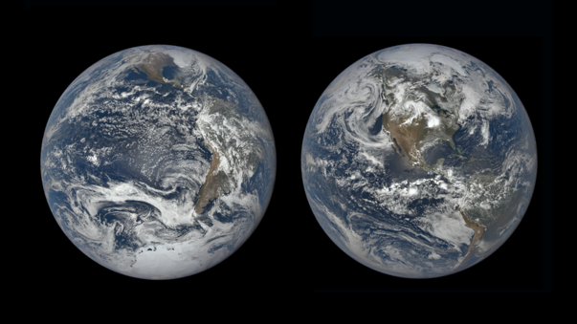
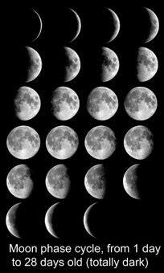
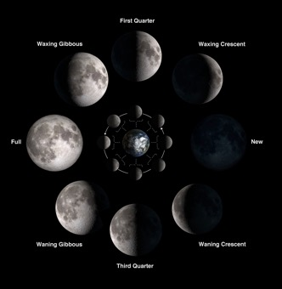
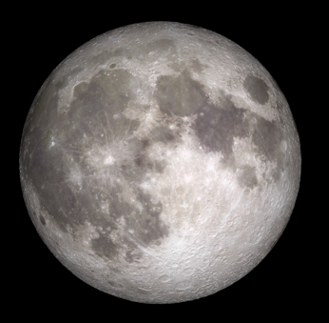

Images
Notes:
Images
Earth
https://solarsystem.nasa.gov/resources/786/blue-marble-2002/
https://nineplanets.org/planets-transparent-background/
https://www.nasa.gov/image-feature/goddard/2021/summer-solstice-in-the-northern-hemisphere
Moon
https://www.nasa.gov/image-feature/goddard/2021/nasa-gazes-at-the-strawberry-moon/
https://nineplanets.org/planets-transparent-background/
https://spaceplace.nasa.gov/oreo-moon/en/Moon_phases_all_L.jpg
https://www.jpl.nasa.gov/edu/images/activities/moonphases.jpg

Slide 8
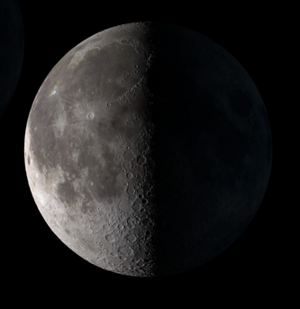
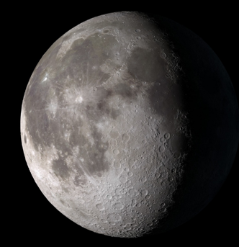
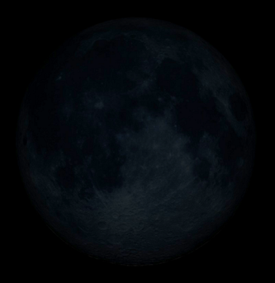
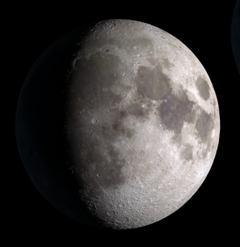
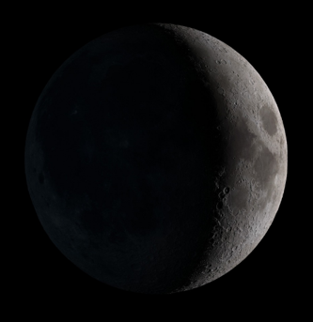
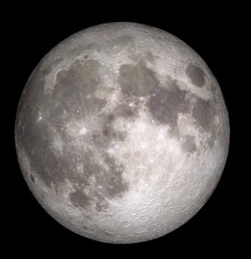
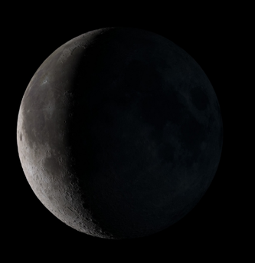
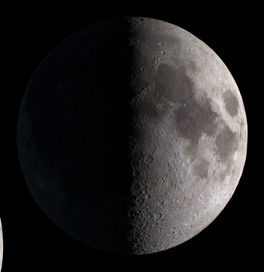
Images – Moon phases
Notes:
https://spaceplace.nasa.gov/moon-phases/en/
https://www.jpl.nasa.gov/edu/images/activities/moonphases.jpg
https://moon.nasa.gov/moon-in-motion/moon-phases/
https://my.girlscouts.org/content/dam/girlscouts-vtk/meeting-aids/Brownie-Mtg-1-Phases-of-the-Moon-Worksheet.pdf

Slide 9
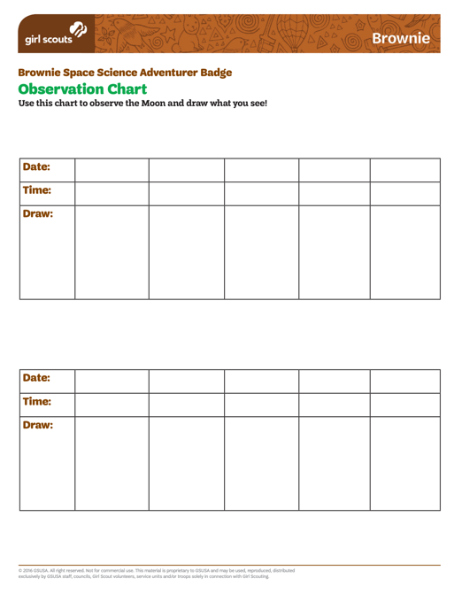
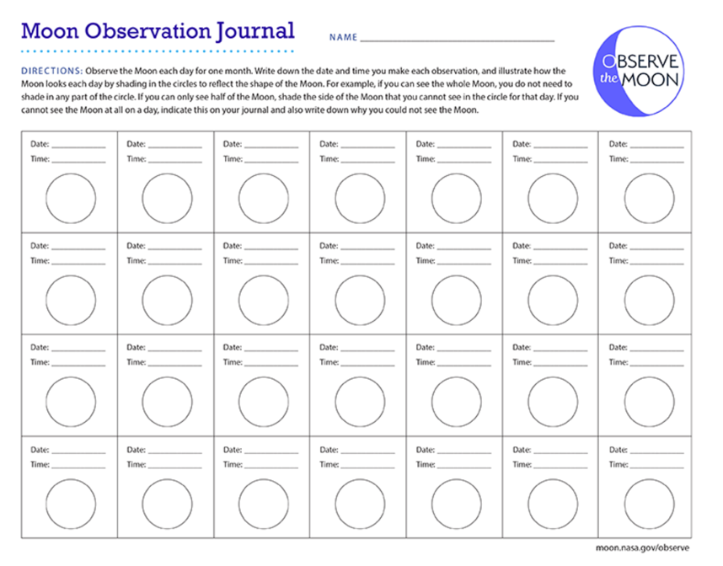
Volunteer Toolkit Resource: Moon Observation NASA for International Observe the Moon Night: Moon Observation
Notes:
https://my.girlscouts.org/content/dam/girlscouts-vtk/meeting-aids/Observation-Chart-Brownie.pdf
https://moon.nasa.gov/observe-the-moon-night/
https://moon.nasa.gov/resources/12/moon-observation-journal/?site=observe%20the%20moon

Slide 10
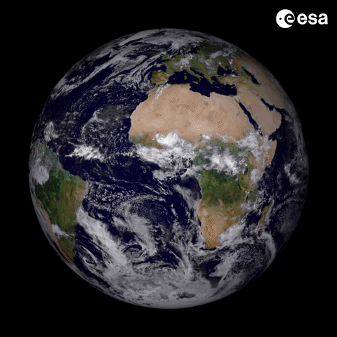
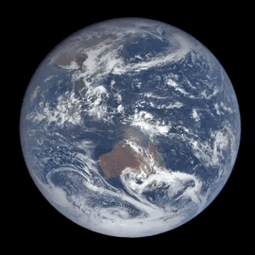
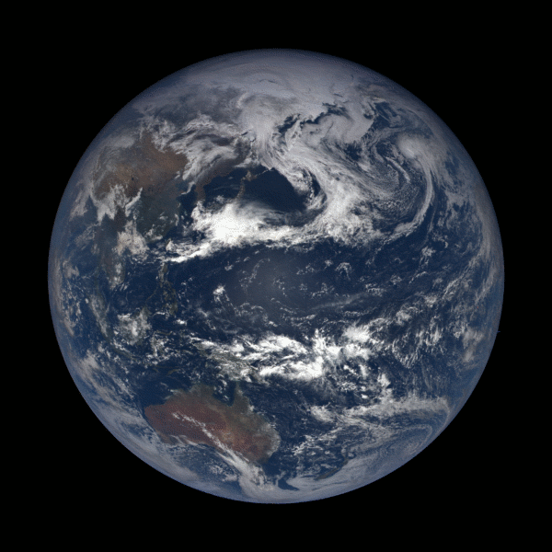
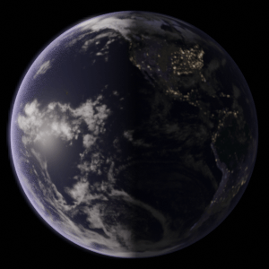
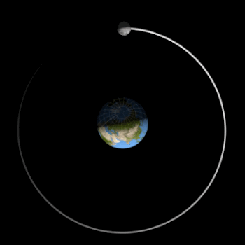
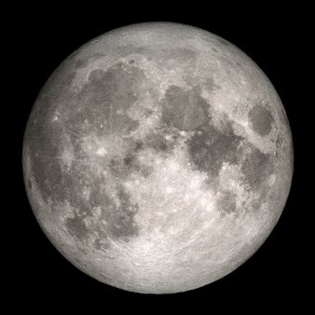
GIFs
🌑 New
🌒 Waxing Crescent
🌓 First Quarter
🌔 Waxing Gibbous
🌕 Full
🌖 Waning Gibbous
🌗 Third Quarter
🌘 Waning Crescent
Notes:
GIFs
Earth
https://svs.gsfc.nasa.gov/12312
https://solarsystem.nasa.gov/system/downloadable_items/2986_earthturn_600.gif
https://media.giphy.com/media/ux6AQI6MBwGqY/giphy.gif
https://media0.giphy.com/media/J0QVUUvPeLS5G/giphy.gif
Moon
https://imagecache.jpl.nasa.gov/images/edu/activities/moonjournal_9-640x350.gif
https://spaceplace.nasa.gov/moon-phases/en/
🌑 New
🌒 Waxing Crescent
🌓 First Quarter
🌔 Waxing Gibbous
🌕 Full
🌖 Waning Gibbous
🌗 Third Quarter
🌘 Waning Crescent

Slide 11

Activity – Golden Sun Song
Oh, golden Sun, Sun, hey there golden Sun
Please shine down on me
Oh, golden Sun, Sun, hey there golden Sun
Hiding behind a tree
These little children are asking you
To please come out so we can play with you
Oh, golden Sun, Sun, hey there golden Sun
Please shine down on, please shine down on,
Please shine down on me
Notes:
Sing to the tune of “Mister Sun” by Rafi
Replace “Mister” with “golden”, or try the more challenging science version “our star the Sun”
Have fun acting out the song with motions for lines like “shine down” and “hiding behind”

Slide 12

Day and Night Dance
Activity
Imagine
1) Your head is the Earth
2) Your nose is a mountain. You are standing on top
3) The screen is the Sun
Notes:
Invite everyone to stand up if they can

Slide 13
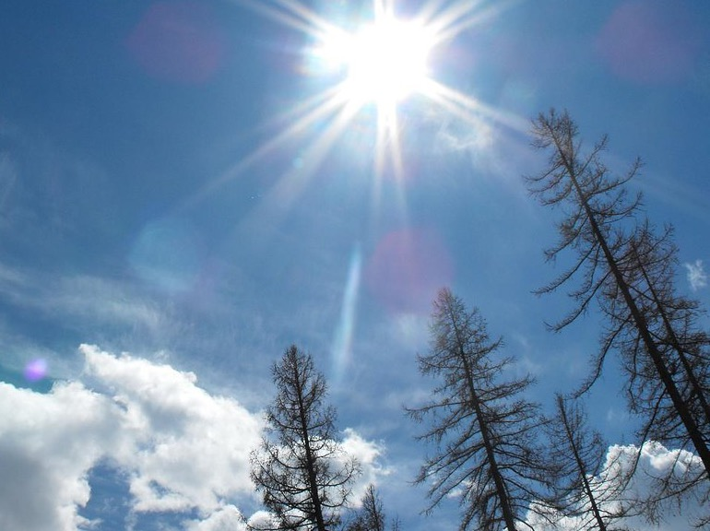
Day and Night Dance
Activity
Stand up
1) Face this screen Sun.
Is it day or night on Mount Nose?
2) Turn left to face away from the screen Sun. Is it day or night?
3) Keep turning until you face the Sun again. How long has it been on Mount Nose?

Slide 14
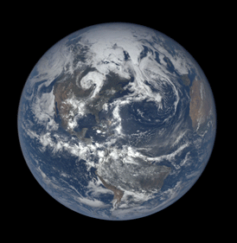
Riddle
The Earth’s rotation really makes my _______
Notes:
Answer: Day

Slide 15
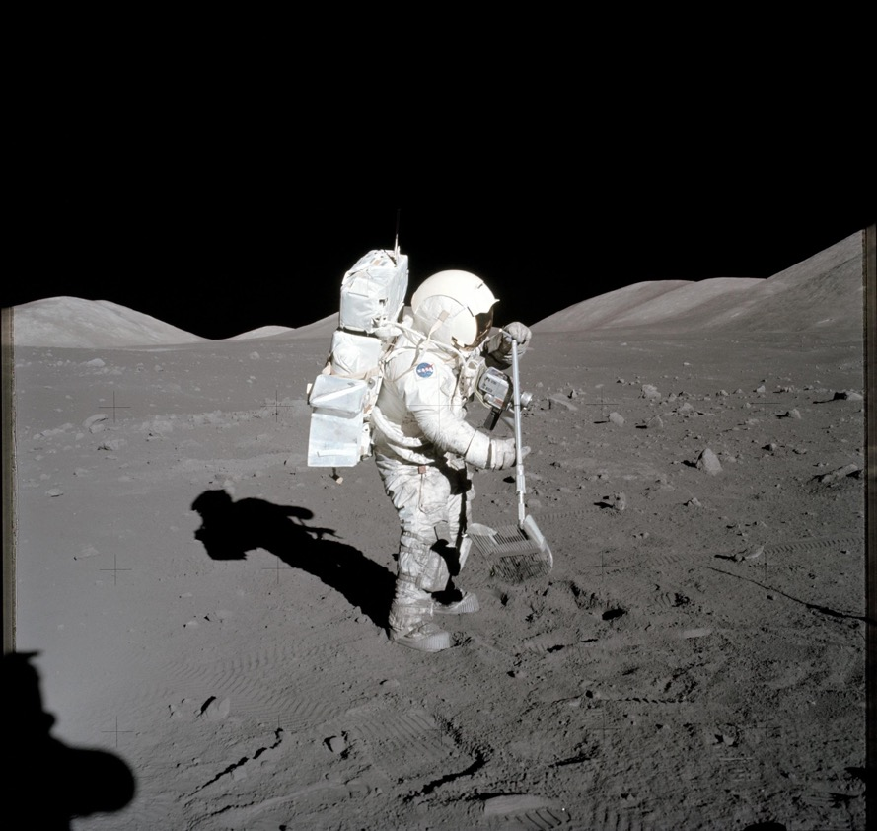
?
Riddle
I can only be where
there is light
yet I disappear when
light shines on me
What am I?
Notes:
Answer: a shadow

Slide 16
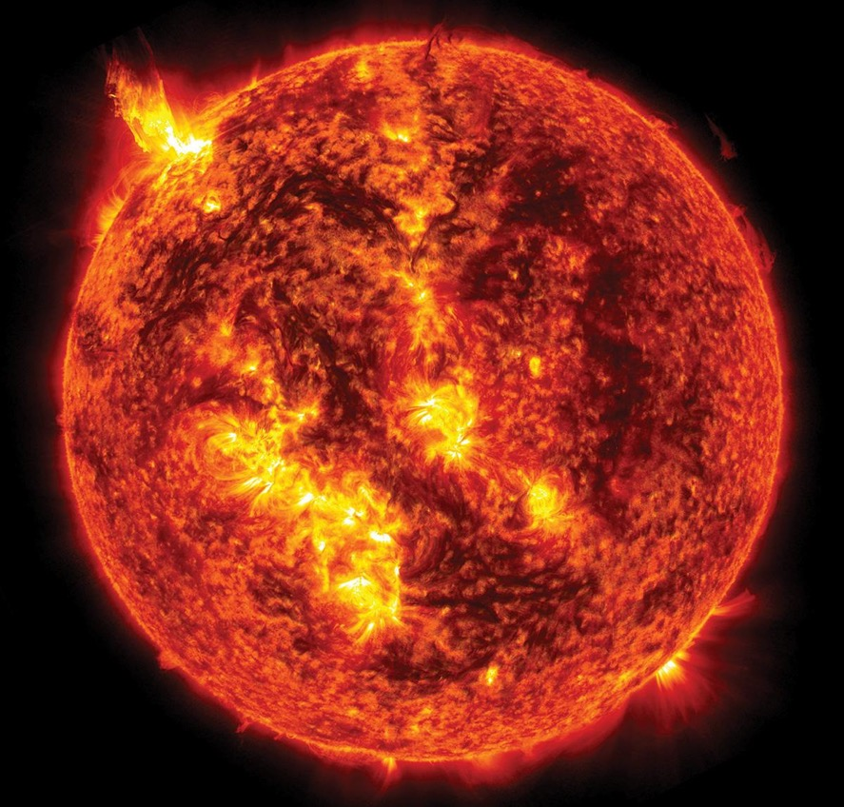
Riddle
You see it rise in the morning
And set when the day is done
It provides us with light and heat
It’s a star that’s called the _ _ _
Notes:
Answer: Sun

Slide 17
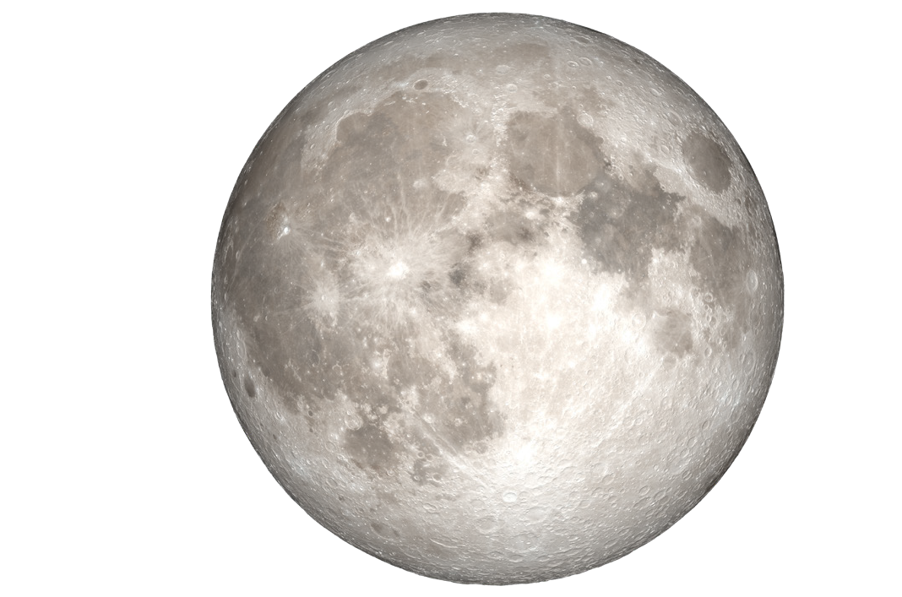
Activity - Share
Imagine
Look at the light and dark parts of the Moon
What shapes look like something you know?
Notes:
What shapes, objects, or animals can you see on the Moon with your imagination?
Share aloud and/or draw what you see on a printout like
https://nightsky.jpl.nasa.gov/docs/CreateMoonStory.pdf
If using Zoom, you may have girls (one at a time) use annotations to circle area they are describing
OR girls can VERY carefully hold a blank piece of paper against the screen and use a crayon to trace the shape they see. Hold up your drawing to the camera to share.

Slide 18
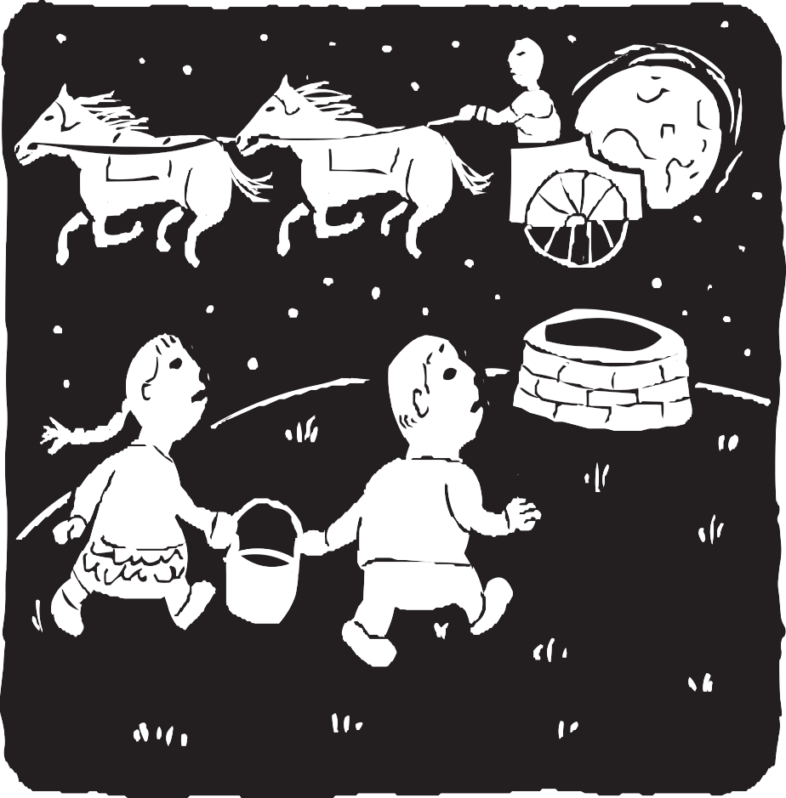


Jack and Jill
Moon Story
Scandinavia
© 2019 Astronomical Society of the Pacific
NASA Night Sky Network: nightskynetwork.org
Notes:
Jack and Jill
Hyuki (Jack) and Bil (Jill) were sent up the hill to fetch a pail of water from a magical well. Water from this well inspired poetry and prophecy. The children were spotted by the man who carries the Moon across the sky each night in his chariot. He scooped them up into his chariot and carried them away. The two children can still be seen there today, along with their bucket and pole. Can you find the splash from the spilled bucket?
https://nightsky.jpl.nasa.gov/docs/MoonStoriesASP2019.pdf

Slide 19
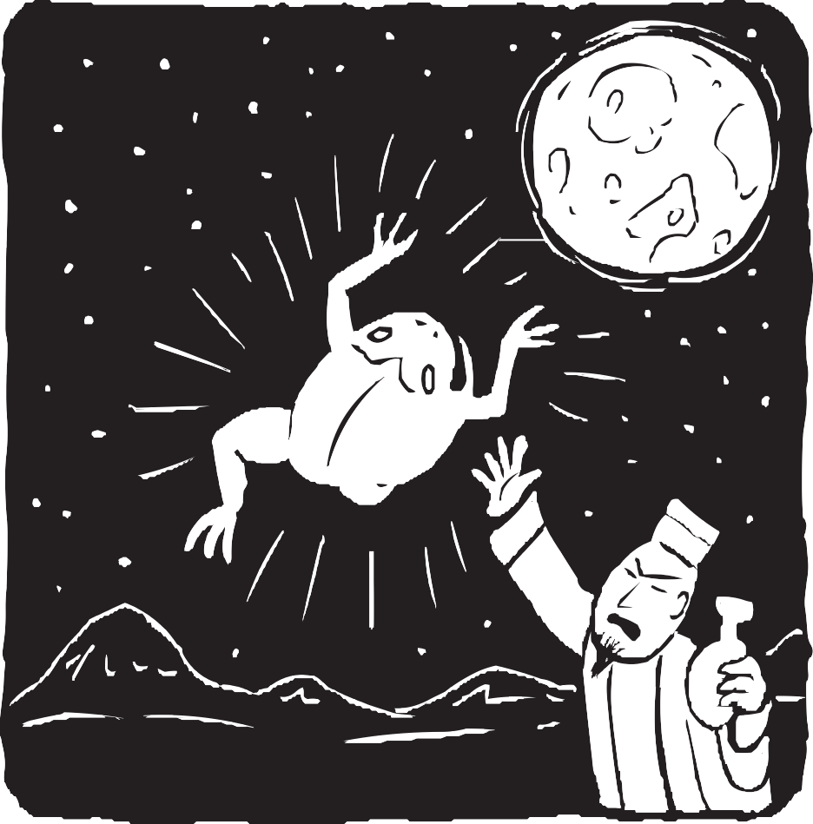

Toad in the Moon
Moon Story
China
© 2019 Astronomical Society of the Pacific
NASA Night Sky Network: nightskynetwork.org
Notes:
Toad in the Moon
Heng O found out that her husband, Sheng I, had discovered the secret of immortality. When she found his magic potion, she drank it and immediately flew out the window up to the Moon.
Sheng I was so angry with what she had done, he turned her into a three-legged toad. Can you see the toad in the face of the full moon?
https://nightsky.jpl.nasa.gov/docs/MoonStoriesASP2019.pdf

Slide 20
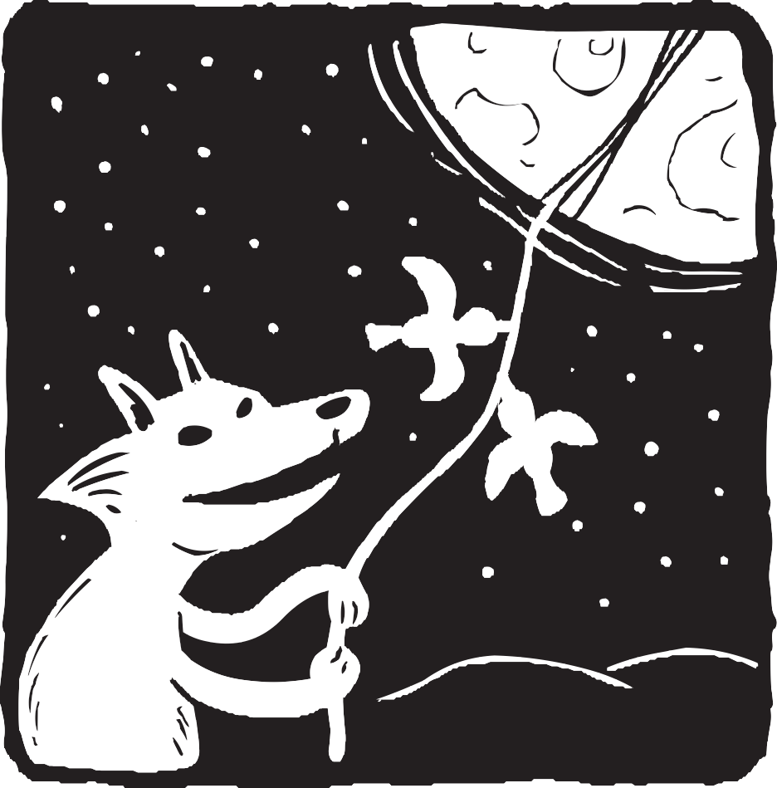

Fox in the Moon
Moon Story
Peru
© 2019 Astronomical Society of the Pacific
NASA Night Sky Network: nightskynetwork.org
Notes:
Fox in the Moon
All that Fox could think about was getting to Moon. After braiding a grass rope long enough to reach Moon, he got help from the birds to fly it up to Moon for him. Once that was done, Fox climbed up the rope. Now the birds say they can see Fox in the Full Moon. Can you?
https://nightsky.jpl.nasa.gov/docs/MoonStoriesASP2019.pdf

Slide 21
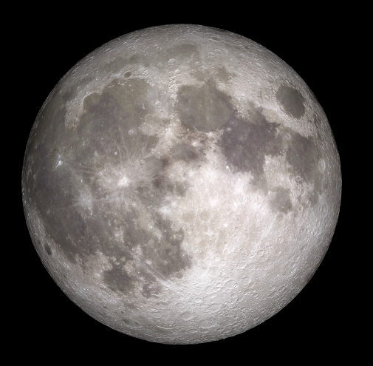
I wonder
Do we always see the same side of the Moon?
Notes:
https://www.nasa.gov/mission_pages/LRO/images/index.html

Slide 22
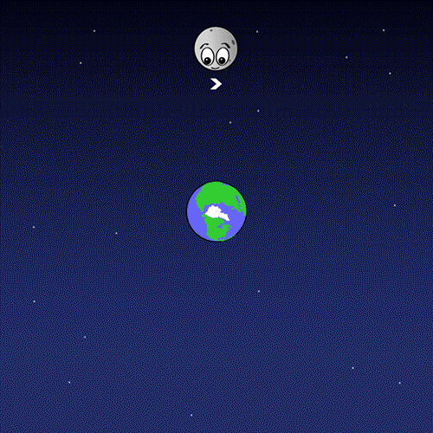
We always see the same side of the Moon
Notes:
https://spaceplace.nasa.gov/all-about-the-moon/en/
True
The same side of the Moon always faces the Earth.

Slide 23
I wonder
How long does it take for the Moon to orbit (go around) Earth?
Notes:
https://imagecache.jpl.nasa.gov/images/edu/activities/moonjournal_9-640x350.gif
https://moon.nasa.gov/moon-in-motion/moon-phases/
https://spaceplace.nasa.gov/moon-phases/en/

Slide 24
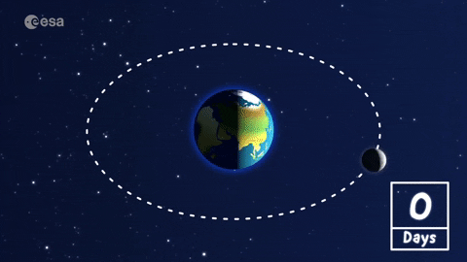
The Moon takes about 29 days – a little under one month – to orbit the Earth
Notes:
https://giphy.com/explore/paxi
https://media0.giphy.com/media/4Zd8V8OMZFGEVJHwH8/giphy.gif?cid=5e214886z9pxutfmqv68kq0rvt472asemlonutxkww6jt1m1&rid=giphy.gif&ct=g
https://spaceplace.nasa.gov/all-about-the-moon/en/
https://moon.nasa.gov/moon-in-motion/moon-phases/

Slide 25
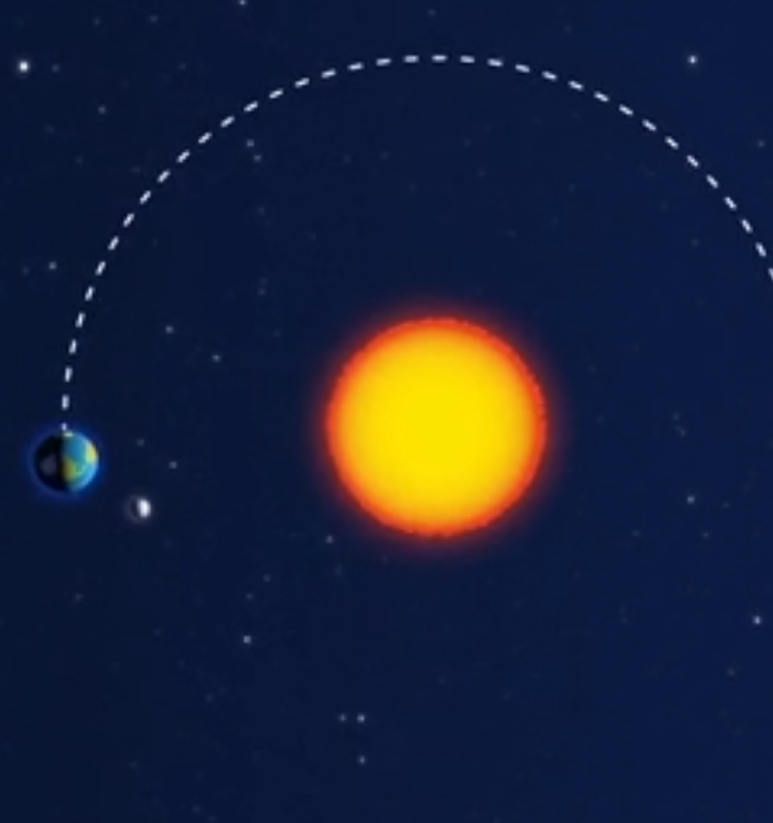
I wonder
How long does it take the Earth to orbit the Sun?
Notes:
https://giphy.com/explore/paxi
https://media1.giphy.com/media/9VaK1come3HVqE5FU5/giphy.gif?cid=5e214886p5gm0n7bbx6c37gnrfag2p3mgsbryqrohiov4y88&rid=giphy.gif&ct=g

Slide 26
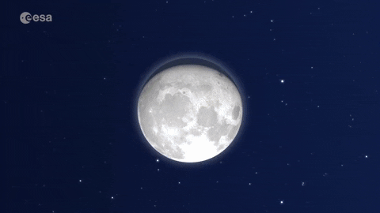
The Earth
takes one year
(about 365 days) to orbit the Sun
Notes:
https://giphy.com/explore/paxi
https://media1.giphy.com/media/9VaK1come3HVqE5FU5/giphy.gif?cid=5e214886p5gm0n7bbx6c37gnrfag2p3mgsbryqrohiov4y88&rid=giphy.gif&ct=g

Slide 27

I wonder
Do other planets have a Moon?
Notes:
https://spaceplace.nasa.gov/how-many-moons/en/

Slide 28
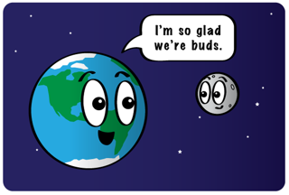
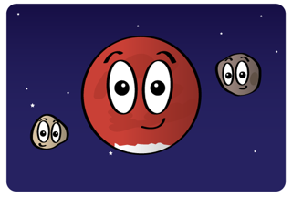
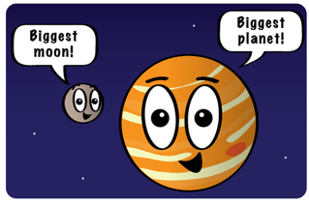
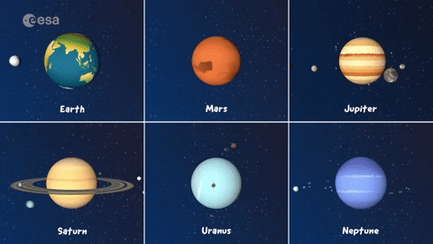
Many other planets have Moons
Notes:
https://spaceplace.nasa.gov/how-many-moons/en/
https://media.giphy.com/media/RJOqbl6wuzYYjxLtxY/giphy.gif
A lot of moons or no moons at all?
We on Earth have just one moon, but some planets have dozens of them. Others don’t have any. Which planets have moons, and which don’t?
Earth (That's us!)
We have one moon.
Mars
Mars has two moons. Their names are Phobos and Deimos. Don’t you wish our moon had a cool name like that?
Jupiter
The giant outer planets have lots of moons. Jupiter, for instance, has 79 known moons! The most well-known of Jupiter's moons are Io (pronounced eye-oh), Europa, and Callisto. Jupiter also has the biggest moon in our solar system, Ganymede.
These moons are so big you can see them with just a pair of binoculars.
For more planets, visit https://spaceplace.nasa.gov/how-many-moons/en/

