Slide 1
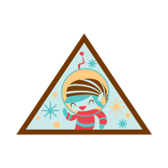
Brownie and Junior - Planets / Solar System
Planets in our Solar System
Meet the Neighbors Background information
Montage of planets. Image credit: NASA/JPL
GSUSA marks and content used with permission of the Girl Scouts of the USA
Notes:
https://www.nasa.gov/images/content/155854main_solar-system-montage-browse.jpg
Slides support Brownie (Meet the Neighbors) and Junior Space Science badge steps about our Solar System

Slide 2
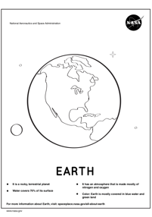
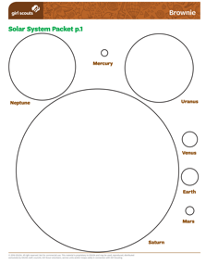
Planets facts, media, activities and more
Online Resources
Links
NASA SpacePlace Solar System page
Girl Scouts Solar System facts sheet
Girl Scouts Solar System images sheet
Girl Scouts planet information sheet
NASA SpacePlace - why is Pluto not a planet?
NASA Solar System page
NASA Solar System Posters
Activities
Girl Scouts planet coloring circles
How to make a Pocket Solar System (Brownie)
Make a Mars Rover GS at Home video (Junior Step 4)
NASA Planet coloring pages
NASA Make a planet mask

Slide 3
Planets books and videos
Online Resources
Books
Dr Seuss No Place Like Space (story)
National Geographic’s First Big Book of Space (science)
Dr. E’s Super Stellar Solar System (science)
The Girl Who Named Pluto: The Story of Venetia Burney (women in science)
Videos
JPL Space Shorts: dwarf planets
Mars In a Minute playlist
How Hard is it to land on Mars?
SpacePlace Solar System came to be
SpacePlace Out Moon isn’t the only
SpacePlace Exoplanets
SpacePlace Where Solar System ends?

Slide 4
Mercury
Planet Pantomime
Mercury only has one sunrise every 180 Earth days
Act like you are amazed to see the sunrise
Notes:
Image: https://solarsystem.nasa.gov/resources/925/solar-system-and-beyond-poster-set/
https://spaceplace.nasa.gov/all-about-mercury

Slide 5
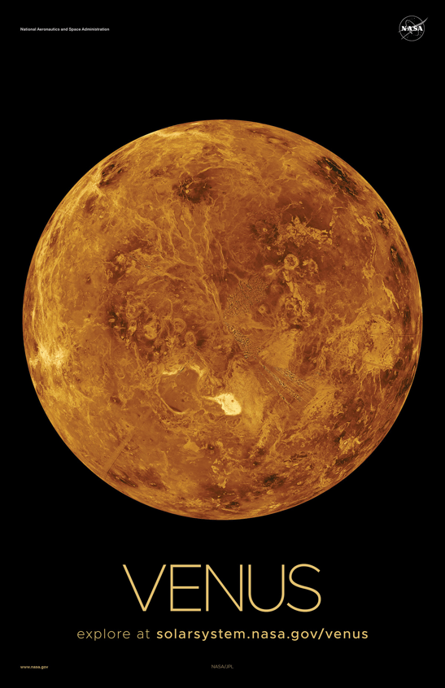
Planet Pantomime
Venus
Venus has an active surface, including volcanoes
Act like you are a volcano!
Notes:
Image: https://solarsystem.nasa.gov/resources/925/solar-system-and-beyond-poster-set/
https://spaceplace.nasa.gov/all-about-venus

Slide 6
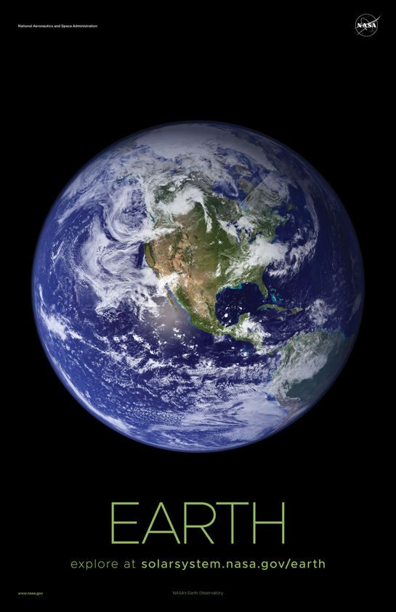
Planet Pantomime
Earth
Earth is the only planet in our Solar System we know of that supports life
Take a deep breath of our amazing Earth air!
Notes:
Image: https://solarsystem.nasa.gov/resources/925/solar-system-and-beyond-poster-set/
https://spaceplace.nasa.gov/all-about-earth

Slide 7
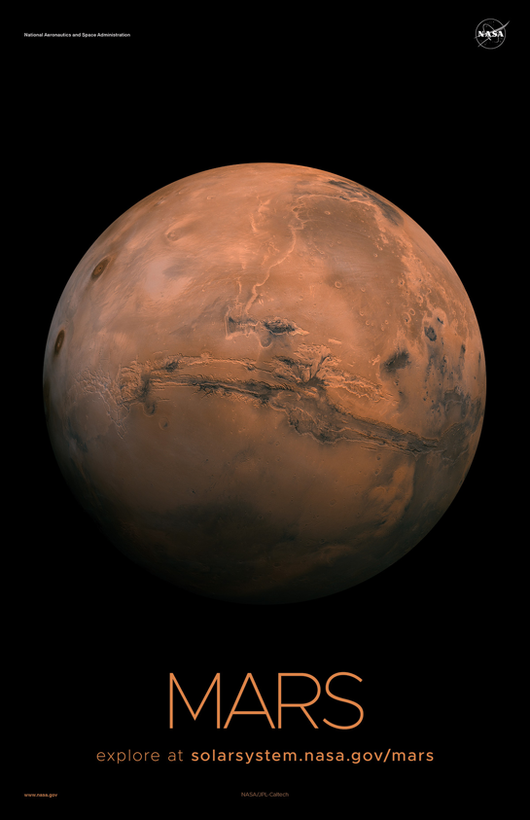
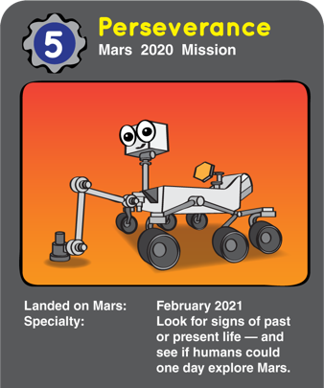
Planet Pantomime
Mars
A rover named Perseverance is exploring Mars for us right now!
Act like a rolling robot, searching for clues about Mars
Notes:
Image: https://solarsystem.nasa.gov/resources/925/solar-system-and-beyond-poster-set/
https://spaceplace.nasa.gov/mars-rovers/en/
https://mars.nasa.gov/mars2020/

Slide 8
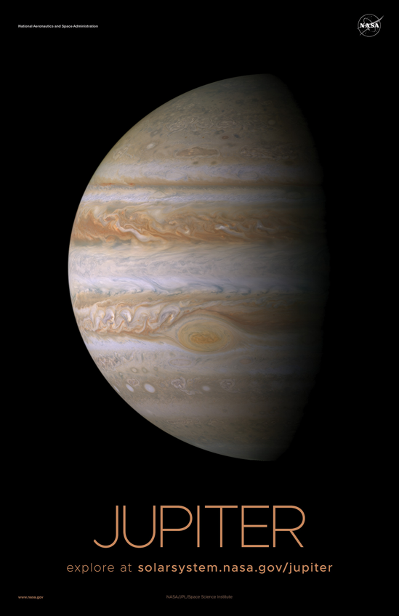
Planet Pantomime
Jupiter
Jupiter is the largest planet in our Solar System and has a very thick atmosphere
Act really big!
Notes:
Image: https://solarsystem.nasa.gov/resources/925/solar-system-and-beyond-poster-set/
https://spaceplace.nasa.gov/all-about-jupiter

Slide 9
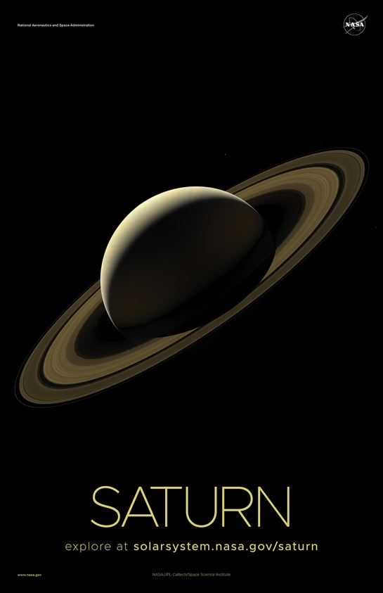
Planet Pantomime
Saturn
Saturn is known for its beautiful rings
Pretend you have a tutu of rings around you
Notes:
Image: https://solarsystem.nasa.gov/resources/925/solar-system-and-beyond-poster-set/
https://spaceplace.nasa.gov/all-about-saturn

Slide 10
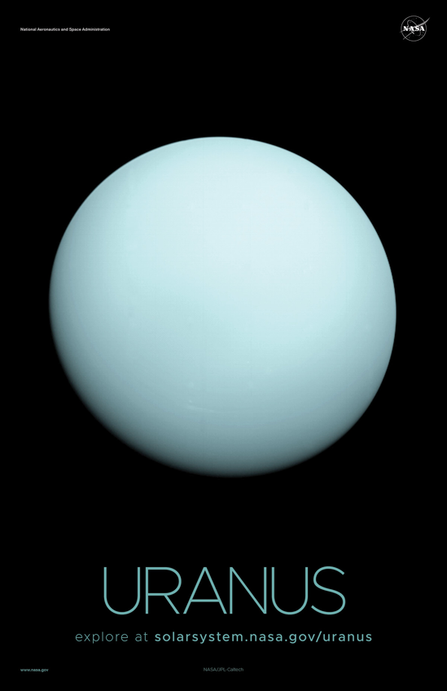
Planet Pantomime
Uranus
Uranus was the first planet to be found with a telescope
Act like you are finding a planet with a telescope for the first time
Notes:
Image: https://solarsystem.nasa.gov/resources/925/solar-system-and-beyond-poster-set/
https://spaceplace.nasa.gov/all-about-uranus

Slide 11
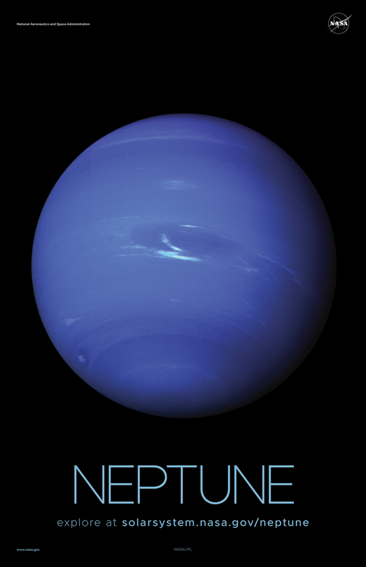
Planet Pantomime
Neptune
Neptune and Earth have similar gravity
Jump up and feel how fast you come back down
Notes:
Image: https://solarsystem.nasa.gov/resources/925/solar-system-and-beyond-poster-set/
https://spaceplace.nasa.gov/all-about-neptune

Slide 12
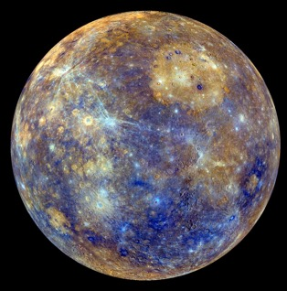
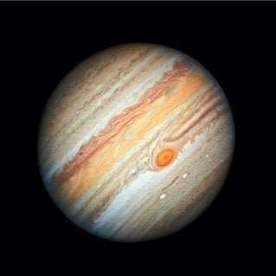
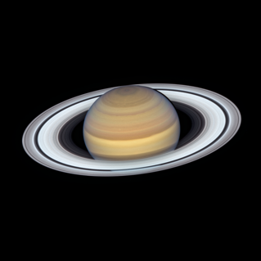
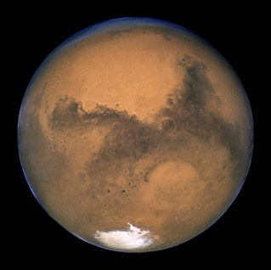
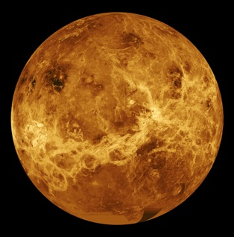
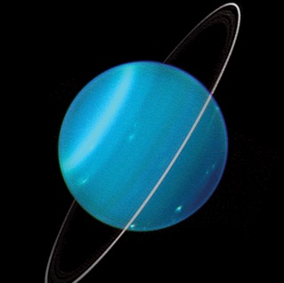
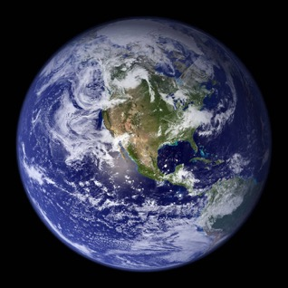
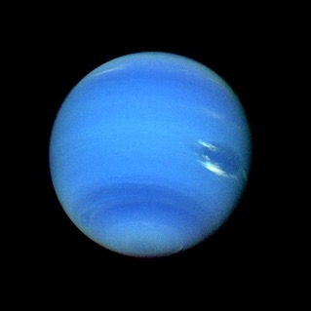
Planet Images
Mercury
Jupiter
Saturn
Mars
Venus
Uranus
Earth
Neptune
Notes:
Scrambled order
Actual order from Sun: Mercury, Venus, Earth, Mars, Jupiter, Saturn, Uranus, Neptune
Top row L to R
https://solarsystem.nasa.gov/planets/mercury/galleries/
https://solarsystem.nasa.gov/planets/jupiter/galleries/
https://solarsystem.nasa.gov/planets/saturn/galleries/
https://www.nasa.gov/images/content/420295main_marsopposition2003_hubble.jpg
Bottom row L to R
https://solarsystem.nasa.gov/planets/venus/galleries/
https://solarsystem.nasa.gov/planets/uranus/galleries/
https://solarsystem.nasa.gov/resources/786/blue-marble-2002/
https://solarsystem.nasa.gov/planets/neptune/galleries/

Slide 13
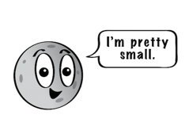
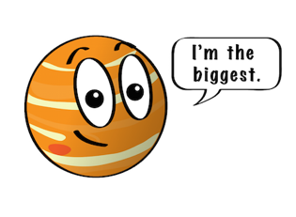
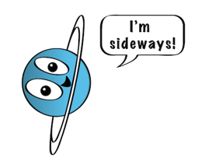
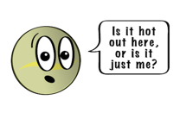
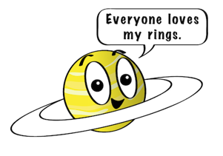
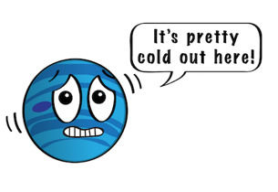
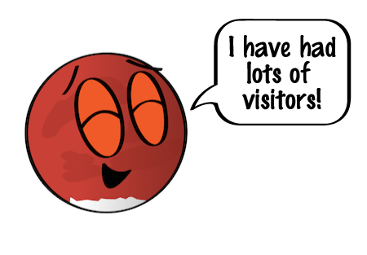
Planet Illustrations
Notes:
https://spaceplace.nasa.gov/menu/solar-system/
Planet order, starting at the Sun
Mercury (small)
Venus (hot)
Earth (life)
Mars (visitors)
Jupiter (biggest)
Saturn (rings)
Uranus (sideways)
Neptune (cold)

Slide 14
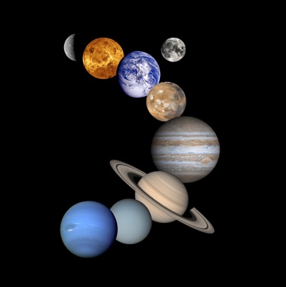
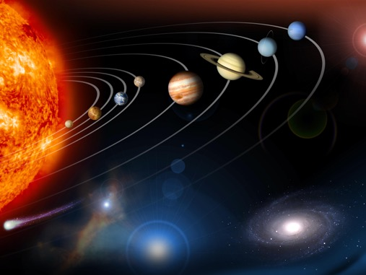
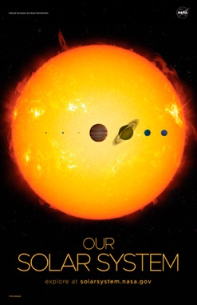
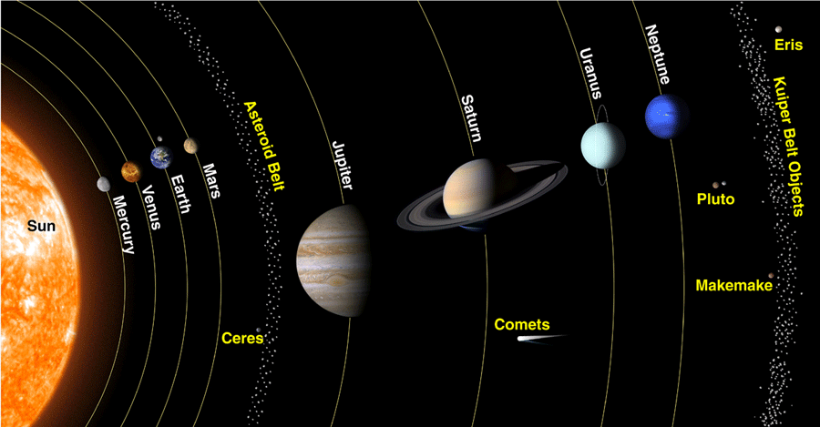
Planet Images
Notes:
https://www.nasa.gov/sites/default/files/thumbnails/image/edu_planets_large.jpg
https://www.nps.gov/laro/learn/photosmultimedia/images/PIA12114_NASA.jpg
https://solarsystem.nasa.gov/resources/925/solar-system-and-beyond-poster-set/
https://solarsystem.nasa.gov/system/downloadable_items/968_solarsys_scale.jpg
https://spaceplace.nasa.gov/review/ice-dwarf/solar-system-lrg.png

Slide 15
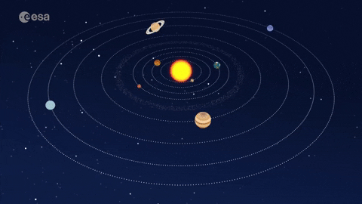
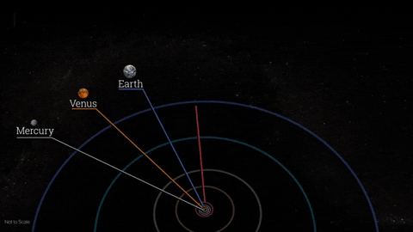
Notes:
https://media4.giphy.com/media/h8sRbOtj55JACfGn8R/giphy.gif
https://media0.giphy.com/media/KEYTEQotUPNQVciNHb/giphy.gif?cid=5e214886dd6cdbc37dbdb2a236ffe7e095fea50fa9c1037d&rid=giphy.gif&ct=g

Slide 16
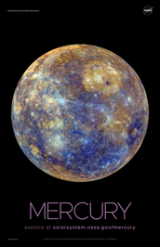
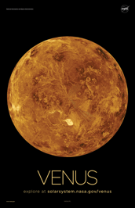
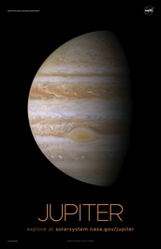
Solar System Saying
Activity
rocky planets
gas giants
ice giants
Many
Very
Excellent
M
Just
Shared
Unique
N
Notes:
NASA Solar System and beyond poster set
Brownie Space Science: Name those planets

Slide 17
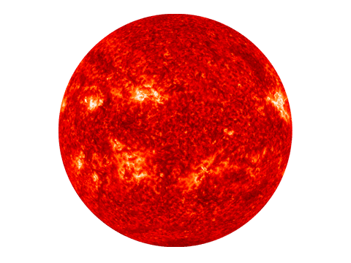
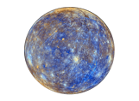
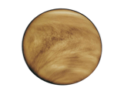
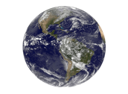
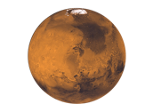
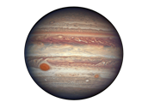
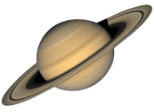
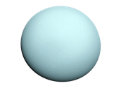
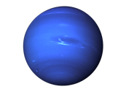
Space Science: Name those planets!
M | V | E | M | J | S | U | N
Notes:
JAMBOARD BACKGROUND
Export as JPG and use as background for virtual collaboration. Add words or “stickies” to each column, then choose one from each to create a phrase to remember the order of the planets.
https://nineplanets.org/planets-transparent-background/
https://spaceplace.nasa.gov/menu/solar-system/
Starting at the Sun, create a mnemonic device to remember the order of the planets.
M is for My, Many, Meet…
V is for Very, Venomous…

Slide 18
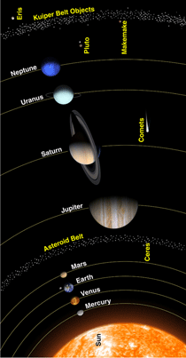
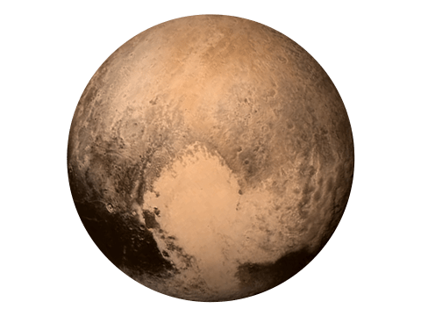
About Pluto
Is Pluto a planet?
It’s a dwarf planet
Notes:
Why is Pluto not a planet?
A while back, Pluto was the ninth planet from the Sun. It was also the smallest planet.
But not anymore. Poor Pluto. Just how did it get "kicked out" of our family of planets? And who are its "real" family members?
Astronomers have already named three other objects in the solar system that are about the same small size as Pluto. They are Ceres [SEAR-ees], Makemake (MAH-kee-MAH-kee], and Eris (AIR-iss]. These objects, along with Pluto, are much smaller than the "other" planets.
Ceres orbits in the asteroid belt between Mars and Jupiter. Makemake, like Pluto, is part of the Kuiper [KI-per] Belt, which is a region of trillions of icy objects orbiting beyond Neptune. Eris' orbit is even farther out. Astronomers have put these objects into a new family called dwarf planets.
More fun facts at
https://spaceplace.nasa.gov/ice-dwarf/en/
https://www.nasa.gov/audience/forstudents/k-4/stories/nasa-knows/what-is-pluto-k4.html
https://solarsystem.nasa.gov/planets/dwarf-planets/pluto/overview/

Slide 19
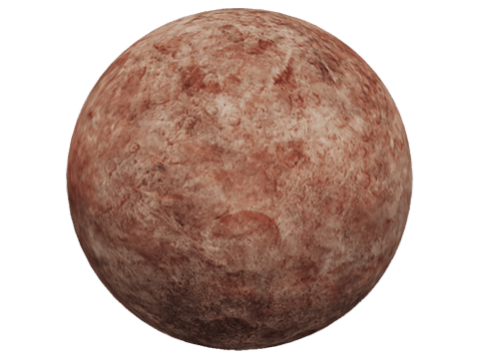
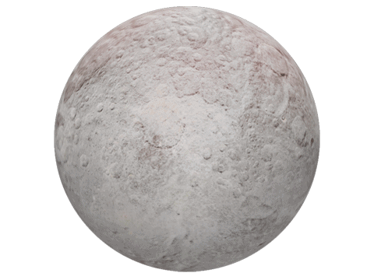
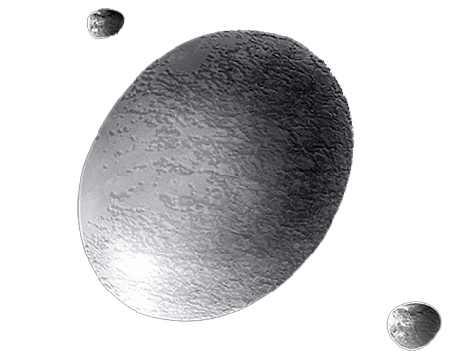
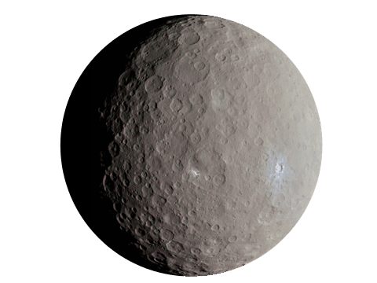
Dwarf Planets
Make Make
Eris
Haumea
Ceres
Pluto
Notes:
Images: https://nineplanets.org/planets-transparent-background/
https://solarsystem.nasa.gov/planets/overview/
https://spaceplace.nasa.gov/ice-dwarf/en/
https://www.nasa.gov/content/planets-moons-and-dwarf-planets

Slide 20
Riddle
How do you organize a space party?
You planet!
Notes:
https://nasaspaceplace.tumblr.com/image/154780432247

