Slide 1



Girl Scout Space Science
Badge Resources
Younger Girls K-5
“Reaching for the Stars: NASA Science for Girl Scouts” supported by NASA Science under Cooperative Agreement No. NNX16AB90A to SETI Institute seti.org/gsstars

Slide 2
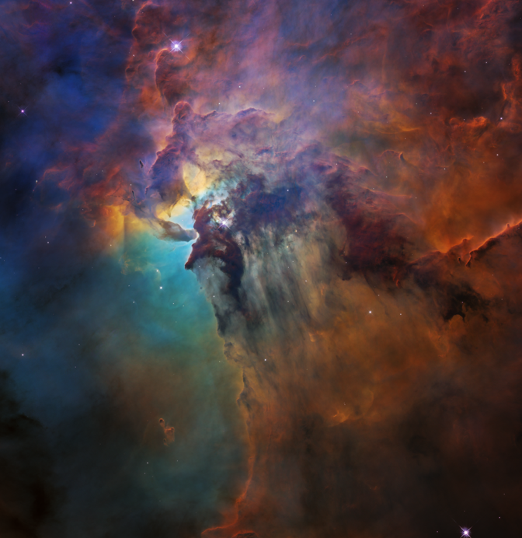
Contents: Supplemental Space Science badge resources including images, links, prompts, virtual activities, and more
Audience: For volunteers leading virtual or in-person Girl Scout Space Science badge programs
How to use: Review badge requirements, then save time by browsing the deck for resources to copy, modify, or otherwise incorporate into Girl Scout program
Note: Slides are not complete badge programs. Please use alongside the complete badge requirements available through Girl Scouts
How to use these slides
Images courtesy of NASA unless noted
See notes for image source links
Notes:
Lagoon Nebula
Credits: NASA, ESA, and STScI
https://www.nasa.gov/feature/goddard/2018/lagoon-nebula-visible-light-view
This colorful image, taken by NASA’s Hubble Space Telescope, celebrates the Earth-orbiting observatory’s 28th anniversary of viewing the heavens, giving us a window seat to the universe’s extraordinary tapestry of stellar birth and destruction.
Badge step overviews & badge booklet links are available on the Girl Scout Badge Explorer
Registered GS volunteers can access free badge requirements, meeting scripts, activity plans & more through the GS Volunteer Toolkit (VTK)

Slide 3
Earning a Space Science Badge
Badges are completed by doing ONE activity from each of FIVE steps (three for Daisies)
Badge step overviews & badge booklet links are available on the Girl Scout Badge Explorer
Registered GS volunteers can access free badge requirements, meeting scripts, activity plans & more through the GS Volunteer Toolkit (VTK)

Slide 4


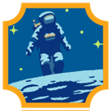
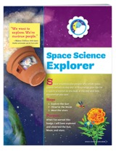
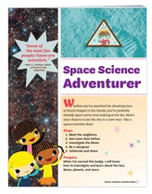
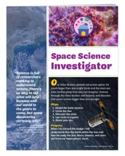
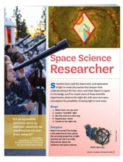
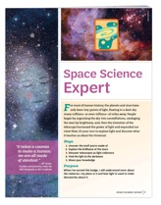
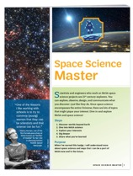
Space Science Badge Levels
Badges
Daisy | Brownie | Junior | Cadette | Senior | Ambassador
Grades K-1 Elementary | 2-3 Elementary | 4-5 Elementary | 6-8 Middle | 9-10 High School | 11-12 High School
Booklets
GSUSA marks and content used with permission of the Girl Scouts of the USA
Notes:
BADGE LEVELS
Badge overviews & links to badge booklets are available on the Girl Scout Badge Explorer. Registered GS volunteers can access free badge requirements, meeting scripts, activity plans & more through the GS Volunteer Toolkit (VTK).
Is there a test?
No. Girl Scout awards and badges are a great way for a girl to explore her interests, learn new skills, and share what she's accomplished. When a Girl Scout completes one activity from each badge step for her level, she’s earned her badge.
How long does it take to earn a badge?
Each activity choice takes about 20 minutes, although some activities are engaging for far more time. While badges can be completed more quickly, remember that earning a badge is about the experience, not a checklist.
Do the steps need to be completed in order?
The first four badge steps can be completed in any order. The fifth badge step focuses on sharing what girls have learned, so should be completed last whenever possible.
Do I need anything special to lead a badge?
The main things you need are the badge requirements, enthusiasm, and a plan. Some activities call for common household materials like drawing supplies, while a few offer chances to use a computer or take a field trip. Every step has a free option.
Do I need to be an expert?
No - these badges were designed with Girl Scout leaders in mind, then tested across the nation. The badge steps can be completed by following the badge booklets alone, using GS Volunteer Toolkit, or both.
What if I don’t know something?
Look it up together using a trusted resource like https://nasa.gov or https://spaceplace.nasa.gov/
What’s the goal of this badge?
Space Science badges were designed for Girl Scouts to build STEM interest, confidence, competence and understanding of the value of science.

Slide 5





Space Science
Badge Themes
Daisies (K-1/younger elementary) earn their Space Science Explorer badge by observing the Sun, Moon and sky.
Brownies (2-3/elementary) earn their Space Science Adventurer badge by digging into the Solar System, Moon phases, and constellations, then sharing their space knowledge with others.
Juniors (4-5/older elementary) earn their Space Science Investigator badge by exploring the planets, scale, and motion of our Solar System, discovering stars and the night sky, then sharing with others.
Cadettes (6-8/middle school) earn their Space Science Researcher badge by investigating visible and invisible light, observing after dark, and taking a step toward conserving the night sky.
Seniors (9-10/high school) earn their Space Science Expert badge by studying the lifecycles and classification of stars, then practicing astrophotography.
Ambassadors (11-12/high school) earn their Space Science Master badge by looking at worlds beyond Earth, doing research, and learning about women at NASA.
Notes:
Badge overviews & links to badge booklets are available on the Girl Scou4 t Badge Explorer. Registered GS volunteers can access free badge requirements, meeting scripts, activity plans & more through the GS Volunteer Toolkit (VTK).
Is there a test?
No. Girl Scout awards and badges are a great way for a girl to explore her interests, learn new skills, and share what she's accomplished. When a Girl Scout completes one activity from each badge step for her level, she’s earned her badge.
How long does it take to earn a badge?
Each activity choice takes about 20 minutes, although some activities are engaging for far more time. While badges can be completed more quickly, remember that earning a badge is about the experience, not a checklist.
Do the steps need to be completed in order?
The first four badge steps can be completed in any order. The fifth badge step focuses on sharing what girls have learned, so should be completed last whenever possible.
Do I need anything special to lead a badge?
The main things you need are the badge requirements, enthusiasm, and a plan. Some activities call for common household materials like drawing supplies, while a few offer chances to use a computer or take a field trip. Every step has a free option.
Do I need to be an expert?
No - these badges were designed with Girl Scout leaders in mind, then tested across the nation. The badge steps can be completed by following the badge booklets alone, using GS Volunteer Toolkit, or both.
What if I don’t know something?
Look it up together using a trusted resource like https://nasa.gov or https://spaceplace.nasa.gov/
What’s the goal of this badge?
Space Science badges were designed for Girl Scouts to build STEM interest, confidence, competence and understanding of the value of science.

Slide 6
Space Science
NASA resources and more
Online Resources
Space Activities
NASA SpacePlace for Kids
NASA JPL Learn
Sun, Earth, Moon and Eclipses Activity Guide PDF
NASA STEM Engagement for students and educators
NASA Kids Club
Space Images, Videos and more
NASA APOD - Astronomy Picture of the Day
NASA Posters: Solar System, SpacePlace, JPL Posters, NASA Missions
NASA Coloring Pages Big list, SpacePlace, Sun, Astronaut, Perseverance, Telescope
YouTube - Crash Course Kids by PBS - stars, Sun
YouTube - SciShow Kids space playlists
A Mighty Girl’s list of Women in Space Science books

Slide 7
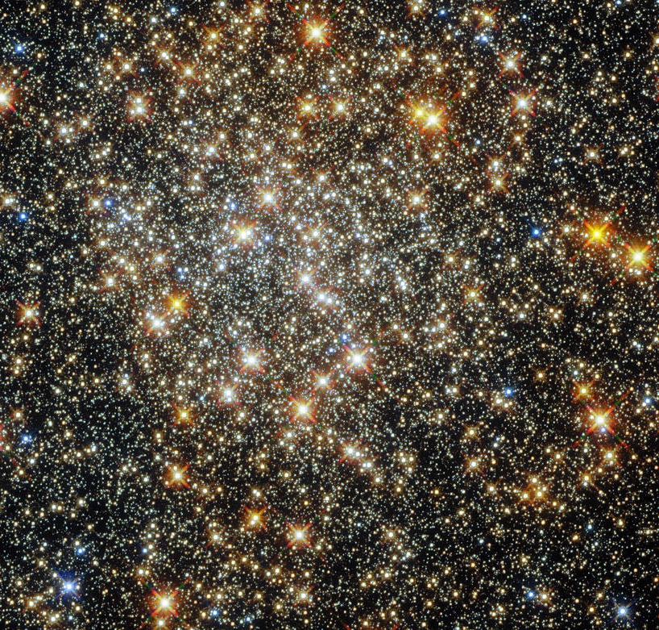
Share
What have heard about space?
Notes:
https://www.nasa.gov/image-feature/goddard/2021/hubble-captures-a-cluster-in-the-heart-of-the-milky-way
Opening share

Slide 8
Share
What do you want to know about space?
Notes:
https://www.nasa.gov/image-feature/goddard/2021/hubble-captures-a-cluster-in-the-heart-of-the-milky-way
Opening share

Slide 9
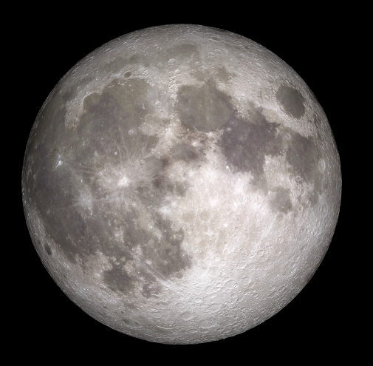
Share
What have you heard about the Moon?
Notes:
https://www.nasa.gov/mission_pages/LRO/images/index.html
Opening share

Slide 10
Share
Have you seen the Moon?
What did you notice?
Notes:
https://www.nasa.gov/mission_pages/LRO/images/index.html
https://www.nasa.gov/image-feature/goddard/2021/nasa-gazes-at-the-strawberry-moon/
Opening share

Slide 11
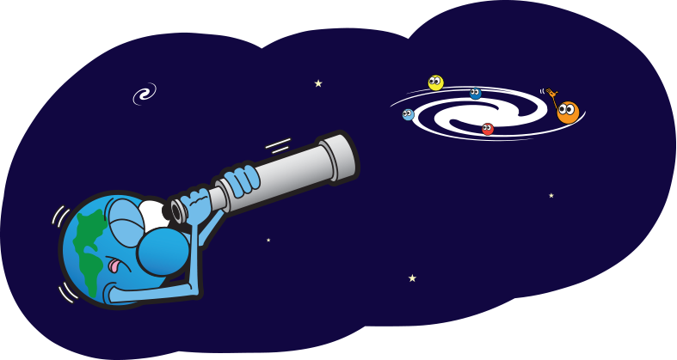
Reflect
One thing
I learned today
Notes:
https://spaceplace.nasa.gov/glossary/en/searching-earth.en.png
Invite GS to reflect on what they did during the meeting.

Slide 12
Reflect
One thing I want to learn more about
Notes:
https://spaceplace.nasa.gov/glossary/en/searching-earth.en.png
Invite GS to reflect on what they did during the meeting.

Slide 13
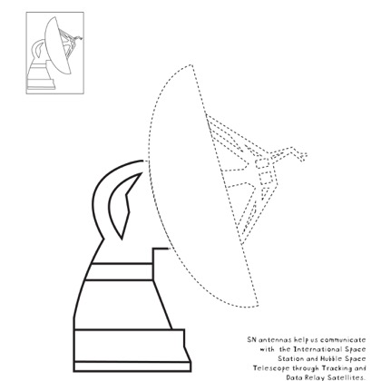
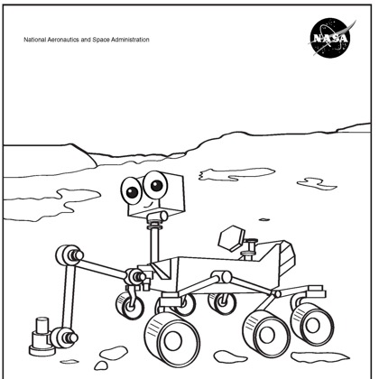
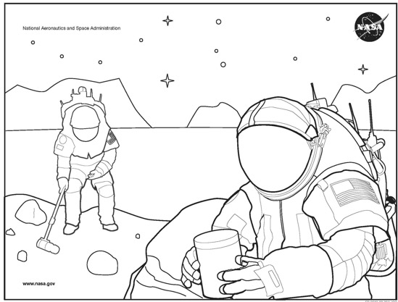
How would you explore our Solar System?
Share
1
2
3
Astronomer
I like to observe and discover new things
Engineer
I like to build things and
solve design challenges
Astronaut
I like to explore new places
and run experiments
Notes:
Images available as free NASA coloring pages at https://spaceplace.nasa.gov/coloring-pages/en/
If time, ask why girls would choose that career

Slide 14


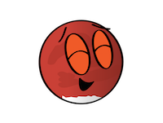
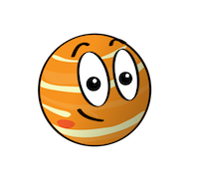

What planet are you today?
Share
1
2
3
4
5
Notes:
Images from NASA Space Place https://spaceplace.nasa.gov/planets/en/
Share how everyone is feeling using these planet cartoon expressions
1 – Mars
2 – Jupiter
3 – Uranus
4 – Mercury
5 – Neptune

Slide 15
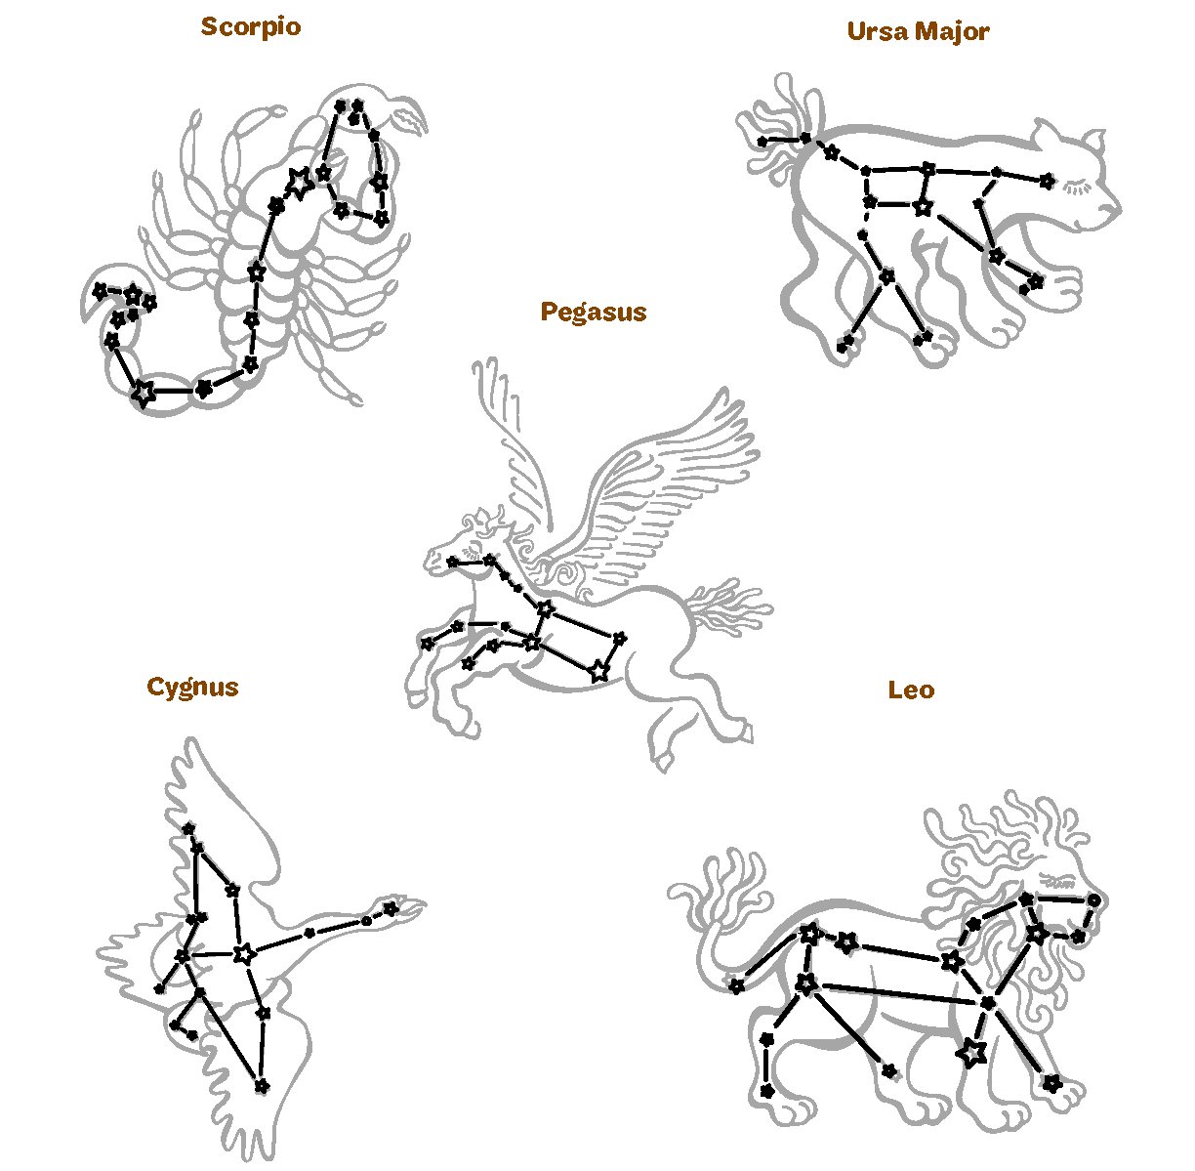
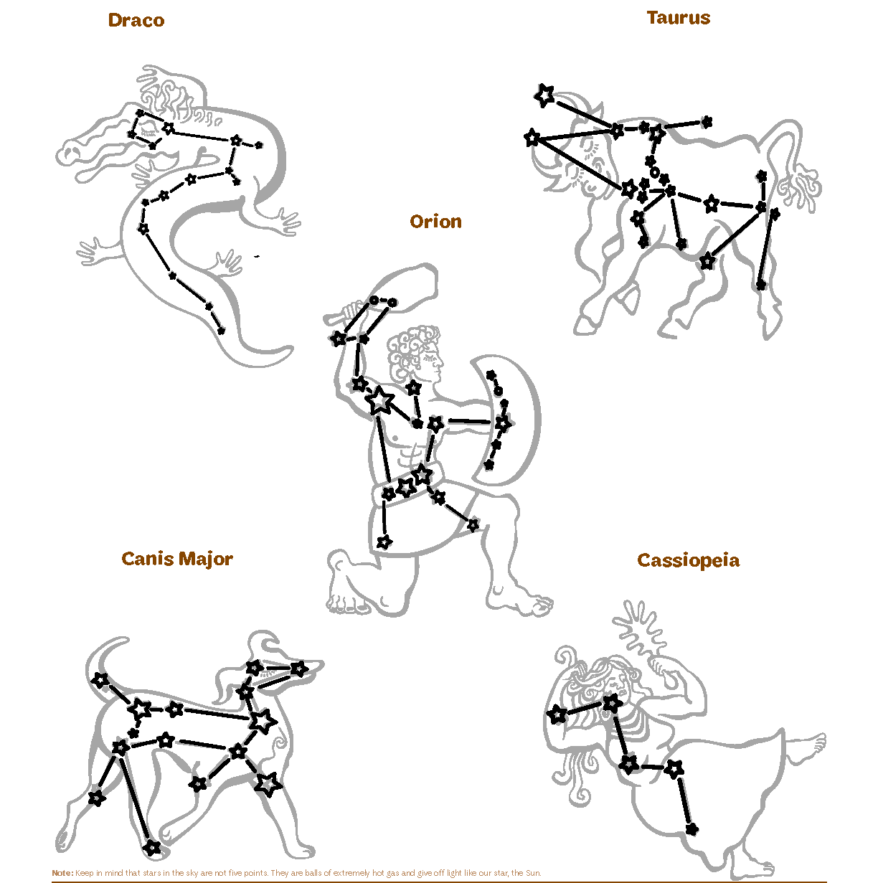
Favorite constellation
Ideas
Share
1
2
3
4
10
5
9
8
7
6
GSUSA marks and content used with permission of the Girl Scouts of the USA
Notes:
GSUSA marks and content used with permission of the Girl Scouts of the USA.
ICEBREAKER
What is your favorite constellation? Why?

Slide 16


NASA Logo
Share
“meatball”
“worm”
Notes:
ICEBREAKER
Share (speak, chat or annotate) which logo they like more
https://commons.wikimedia.org/wiki/File:NASA_Worm_logo.svg
https://en.wikipedia.org/wiki/NASA_insignia

Slide 17
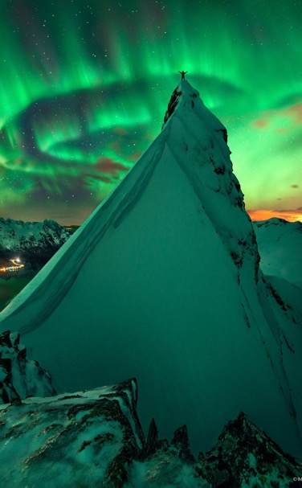
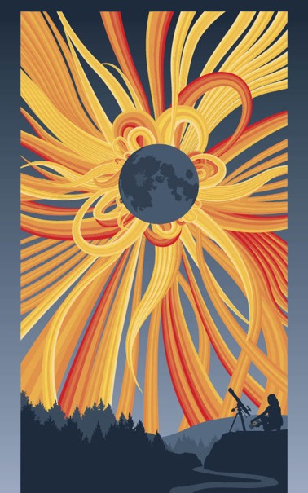
Rather see
Share
In Green Company: Aurora over Norway
Image Credit & Copyright: Max Rive
Eclipse
Aurora
Notes:
ICEBREAKER
Share (speak, chat or annotate) which space wonder they’d like to see more
Would you rather see an aurora, where the sky fills with streaks of colorful lights caused by disturbances in the magnetosphere.
https://apod.nasa.gov/apod/ap141103.html
Or a total solar eclipse, where the moon blocks the sun
https://eclipse2017.nasa.gov/
https://science.nasa.gov/get-involved/toolkits/earth-day-posters

Slide 18
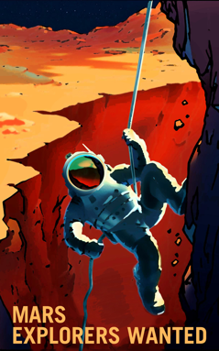
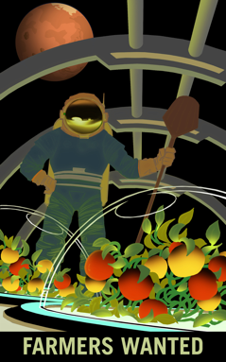
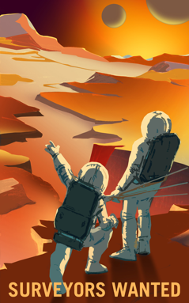
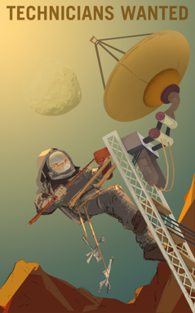
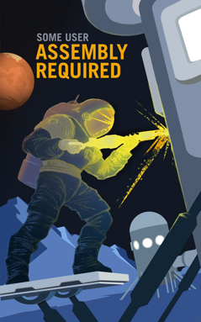
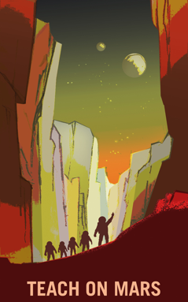
Mars Explorers Wanted
Tag Yourself
Share
Explorers on belay
I would bravely go where no person has gone before
Grow that garden
I would cultivate food for my crew to survive on Mars
What’s out there?
I would make the maps we need to navigate the Martian terrain
Engineer the way
I would install and repair the tools we use to explore and communicate
Build a solution
I would build the equipment we use to safely travel extreme places
Love to share
I would make learning about important discoveries fun
https://mars.nasa.gov/multimedia/resources/mars-posters-explorers-wanted/
Notes:
https://mars.nasa.gov/multimedia/resources/mars-posters-explorers-wanted/
ICEBREAKER
What job on Mars would fit you best / would you like to do? Why?

