Slide 1
Stars Meet the stars See more than before Be a stargazer Discover the stars Use tools to explore
Daisy, Brownie, and Junior - Stars
Image: X-ray: NASA/CXC/MSSL/R.Soria et al, Optical: AURA/Gemini OBs
GSUSA marks and content used with permission of the Girl Scouts of the USA
Notes:
https://www.nasa.gov/mission_pages/chandra/multimedia/fireworks-galaxy-ngc6946.html
Slides support Daisy, Brownie, and Junior Space Science badge steps about the stars and constellations

Slide 2
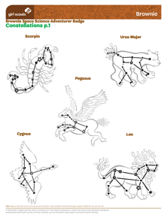
Stars information and interactives
Online Resources
Links
NASA Space Place Stars page
Girl Scout’s Stars fact sheet
Girl Scout constellation drawings
Girl Scout constellation cup template
Figures in the stars - constellations interactive
Legends in the Sky – constellation stories PDF
Official IAU Constellations
How to pronounce constellations
Stellarium virtual planetarium

Slide 3
Stars books
Resources
Books
Zoo in the Sky: A Book of Animal Constellations (stories)
Curious George Discovers the Stars (story)
Sky Gazing by Meg Thacher (science)
What We See in the Stars: An Illustrated Tour of the Night Sky (science & stories)
Always Looking Up! Nancy Grace Roman, Astronomer (women in science)
Look Up!: Henrietta Leavitt, Pioneering Woman Astronomer (women in science)
Annie Jump Cannon, Astronomer by Gerber & Wald (women in science)

Slide 4
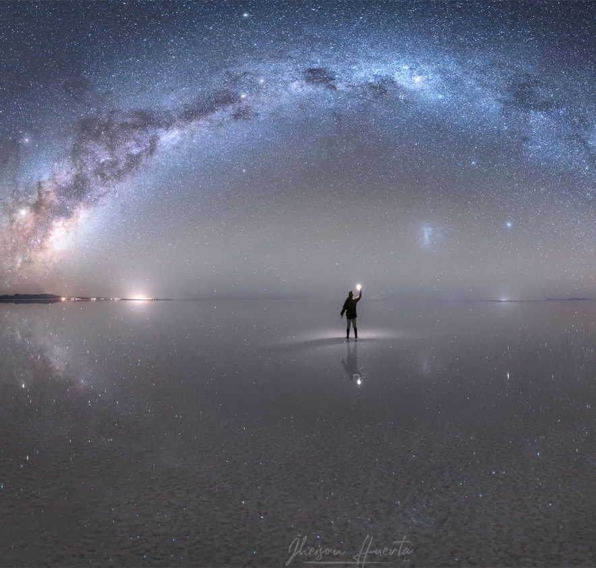
About Constellations
Share
Have you noticed how stars in the sky can look like shapes?
Do you know the names of any constellations?
Notes:
https://apod.nasa.gov/apod/ap191022.html
Image Credit & Copyright: Jheison Huerta
Opening share

Slide 5
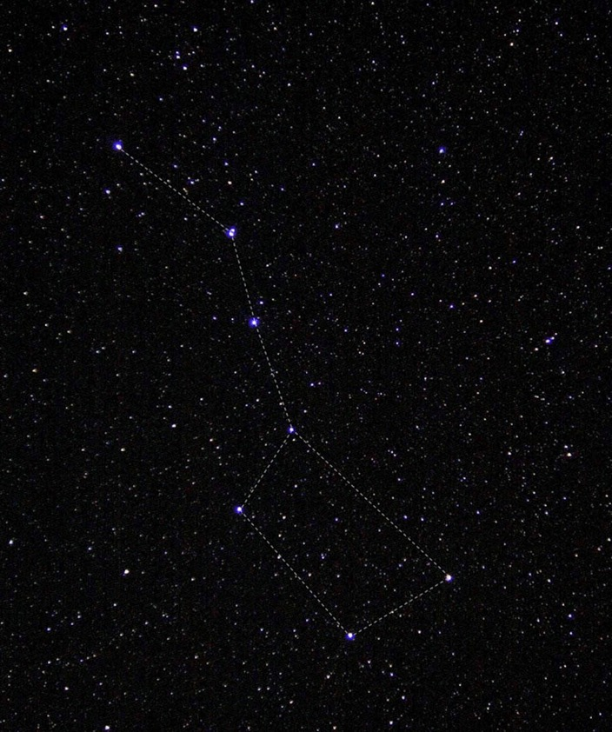
About Constellations
Constellations
Constellations are patterns of stars in the sky – like connect the dots!
Astronomers agree to use the same 88 constellations to map the sky for science.
Notes:
This group of stars is called the "big dipper." If you trace a line between the stars, it looks like a ladle, or dipper, that you'd use to dip soup from a pot. This photo of the big dipper was taken by an astronaut on the International Space Station, but you can often see this group of stars from the ground, too! Credit: NASA/Donald R. Pettit
Why would maps of the stars be important for astronomers?
https://spaceplace.nasa.gov/constellations/en/
https://www.iau.org/public/themes/constellations/

Slide 6
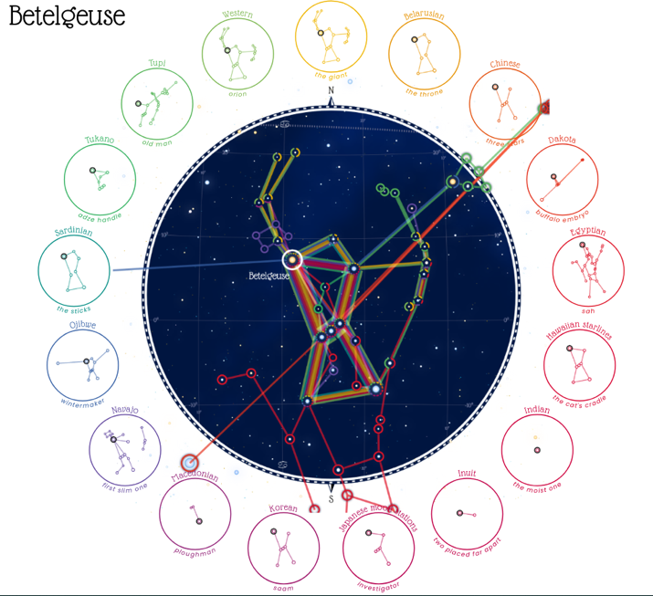
About Constellations
Constellations
People around the world have created stories about the stars
Figures in the Stars
Notes:
Around the world, many people have created different constellations and stories about them.
If time, screen share Figures in the Sky and explore together
While many people know those 88 constellations used by scientists to map the sky, let’s dig a little deeper and look at some constellations from many cultures.

Slide 7
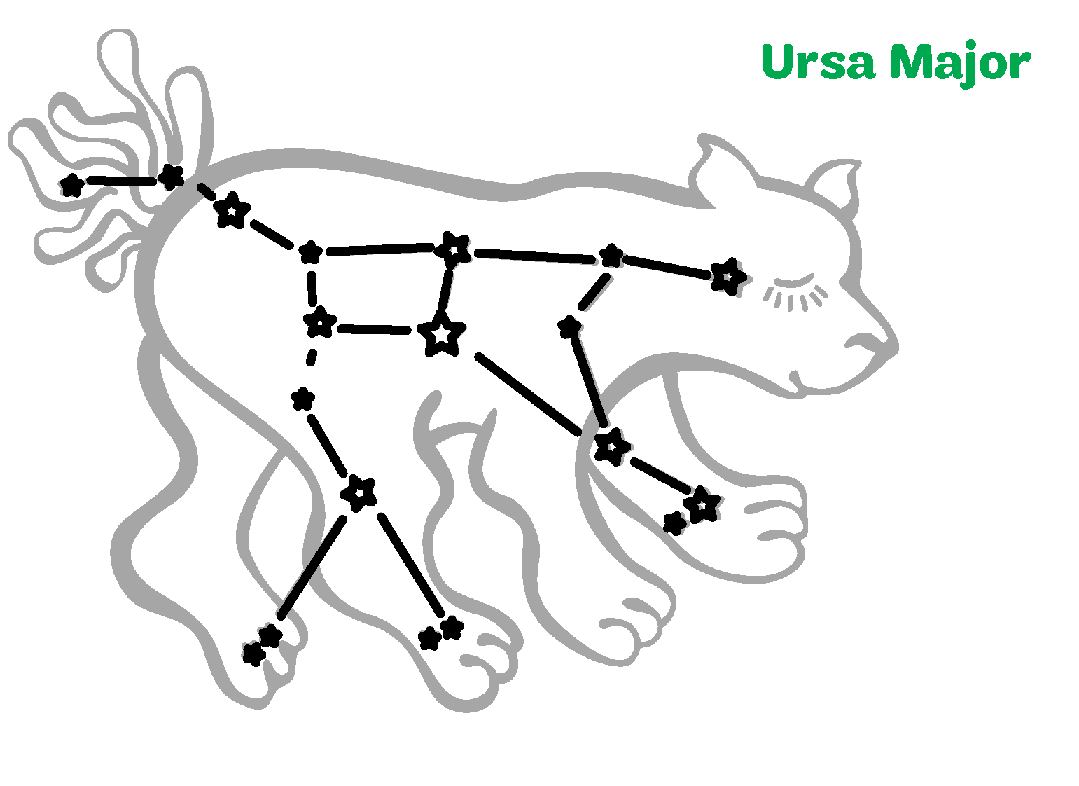
Constellations
What do you see?
Big Dipper
GSUSA marks and content used with permission of the Girl Scouts of the USA
Notes:
ON YOUR HONOR: constellation images courtesy of GSUSA for use in Girl Scout program. GSUSA marks and content used with permission of the Girl Scouts of the USA
Look at these stars.
Do you see how these stars show the basic outline, and then we connect the dots with our imagination so we can see an animal or person?
Click to advance
This is one of the most well known constellations. It is called Ursa Major, or the Great Bear.
Click to advance
It also contains a star pattern – known as an asterism – called the Big Dipper

Slide 8
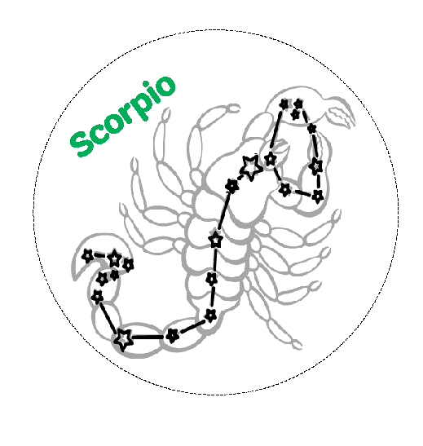
Constellations
What do you see?
GSUSA marks and content used with permission of the Girl Scouts of the USA
Notes:
ON YOUR HONOR: constellation images courtesy of GSUSA for use in Girl Scout program. GSUSA marks and content used with permission of the Girl Scouts of the USA
Today, you’re going to make a star pattern of your own. Let’s first practice one together.
I put some stars on the screen. Look at them and use your imagination.
What do you see?
From June through September, the red star Antares (an-tare-ees) has fascinated skygazers throughout history and around the world. The Greeks saw the heart of a scorpion and we call this area of the sky Scorpius.
Both the Chinese and Japanese cultures see a heart.
Indian legends call this star “the eldest one.”
Ancient Egyptians saw a flock of birds in this area.

Slide 9
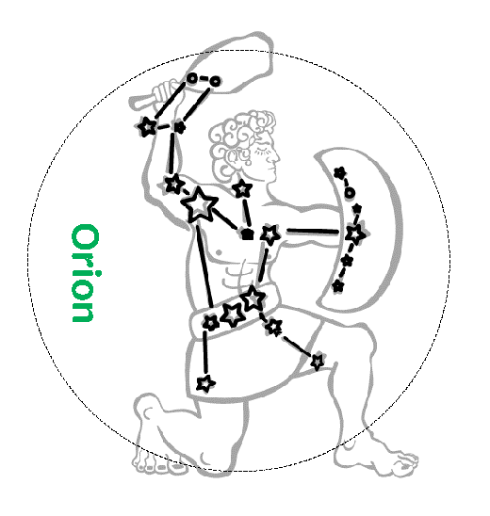
Constellations
What do you see?
GSUSA marks and content used with permission of the Girl Scouts of the USA
Notes:
ON YOUR HONOR: constellation images courtesy of GSUSA for use in Girl Scout program. GSUSA marks and content used with permission of the Girl Scouts of the USA
Today, you’re going to make a star pattern of your own. Let’s first practice one together.
I put some stars on the screen. Look at them and use your imagination.
What do you see?
In November through February, the red star Betelgeuse (bee-tel-juice or bay-tel-gyse) is high in the sky. In the Greek tradition, this is the shoulder of the hunter Orion, one of the most well-known constellations. There are many bright stars in this area of the sky.
North American Dakota tribe see a baby buffalo.
Brazilian Tucano people see the handle of a wood carving tool.
The Boorong (Aboriginal tribe) in Australia see a foot of a dancing man.
Ancient Macedonians were a farming culture and saw a plough.

Slide 10
Space Science: Change a Constellation
Notes:
Use as a Jamboard background, annotate, or print paper handouts.
Resource at https://nightsky.jpl.nasa.gov/download-view.cfm?Doc_ID=666
Legends in the Sky - Constellation Tales from Around the World
[Activity & Handout - Big Astronomy] (English and Spanish)

Slide 11
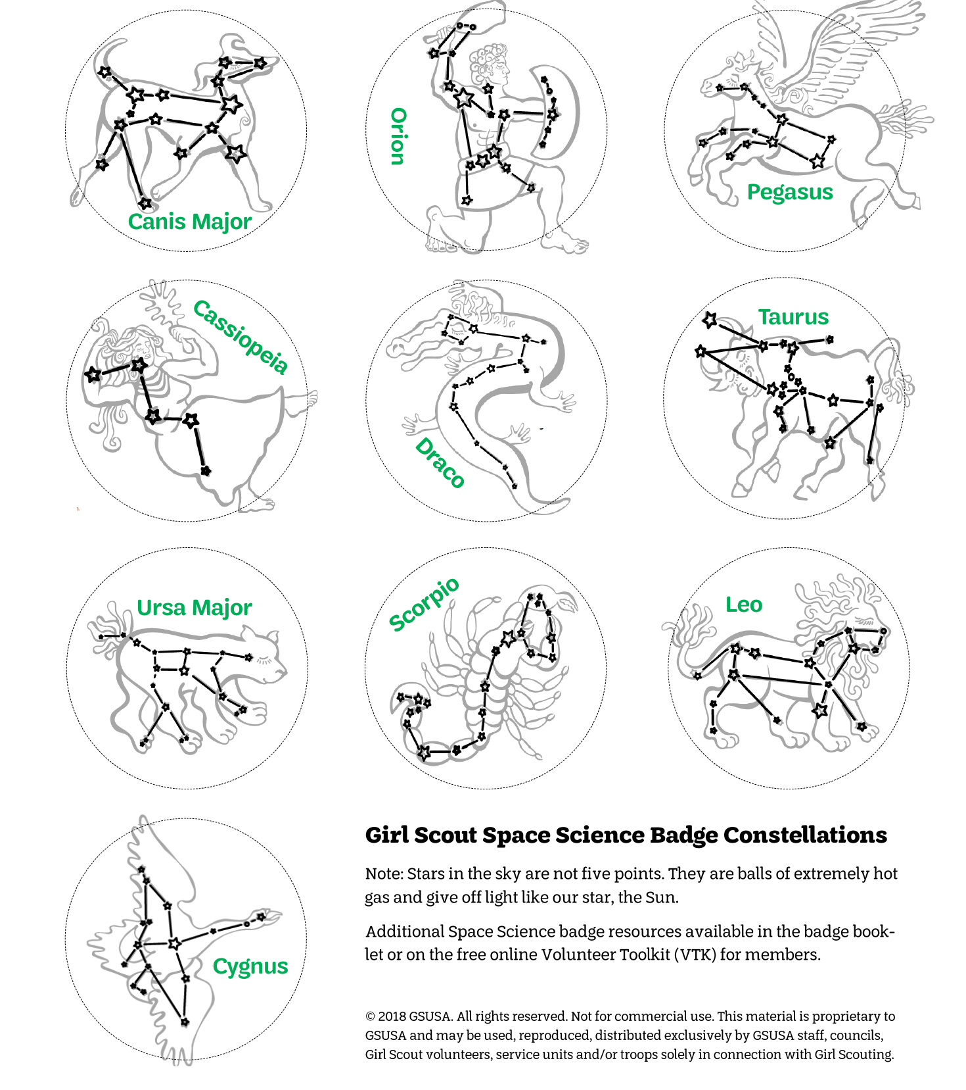
Badge Activity Modification: Constellation Viewer Cups
Make a Constellation Viewer
Materials
❑ constellation circles printout
❑ scissors
❑ paper cup ~8 oz
❑ glue stick
❑ push pin - “giant” ones work well
❑ single bulb light - try a phone flashlight
❑ dark space
Instructions
Cut out a constellation circle along the dotted line
Put a cup open side-down on a table, then glue your constellation on top of the cup
Use a push pin to make a hole for each star
Add light to your constellation cup by looking through at an inside light (never the Sun) or shining a flashlight through. What do you see?
NEEDS link to PDF once posted online
Notes:
NEEDS link to PDF once posted online

Slide 12
Night Sky Observing
What’s Up
Printable Sky Maps by month
Time & Date Astronomy: sunrise & moonrise times
Night Sky Network: Night Sky Planner
Interactive Sky Chart
Sky watching tips from NASA
Activities
Attend a local Night Sky Network Star Party
Girl Scout Star Party Tips
GS Junior - Nighttime Scavenger Hunt
Night Sky Network’s Celestial Treasure Hunt
Spot the International Space Station
Tools
Make a paper star wheel - Uncle Al’s or Sky & Telescope
Make a paper Moon Phase Calendar
Book: Sky Gazing by Meg Thacher
Astrophotography
Girl Scout astrophotography tips
NASA: Photography Guide of the Moon

Slide 13
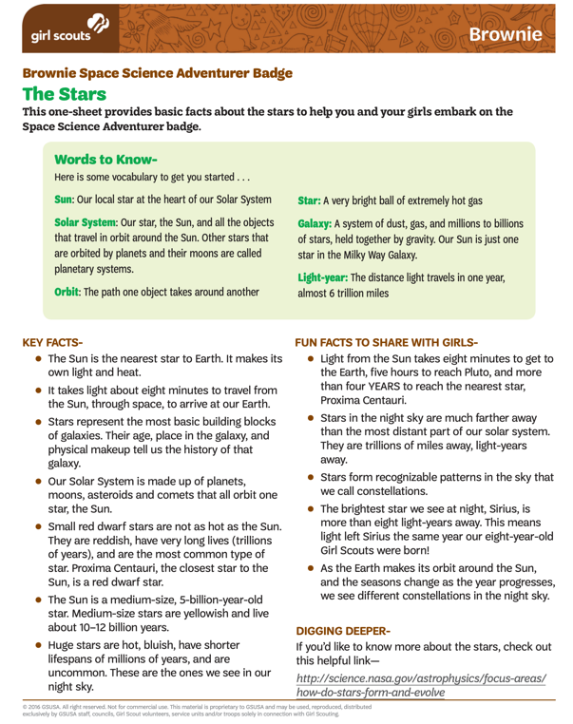
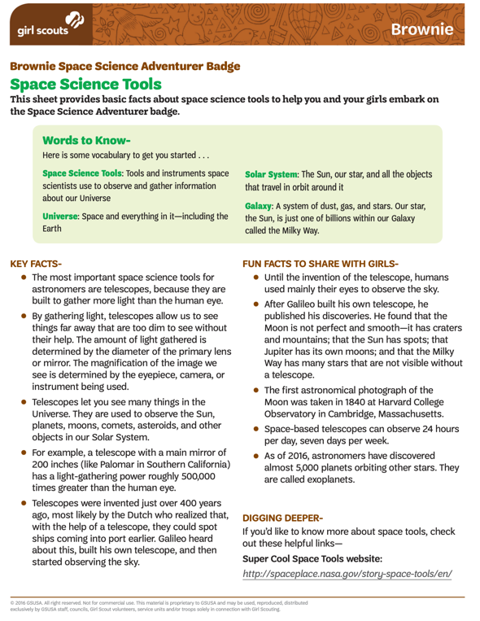
Volunteer Toolkit Resource: Stars & Space Science Tools
Notes:
https://my.girlscouts.org/content/dam/girlscouts-vtk/meeting-aids/The-Stars-Brownie.pdf
https://my.girlscouts.org/content/dam/girlscouts-vtk/meeting-aids/Brownie-Mtg-3-Space-Science-Tools.pdf

Slide 14
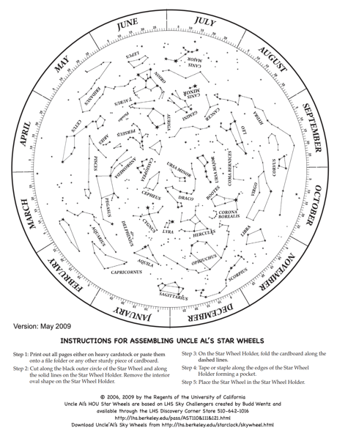
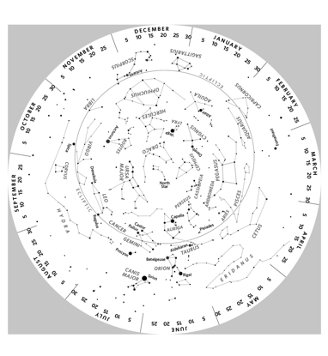
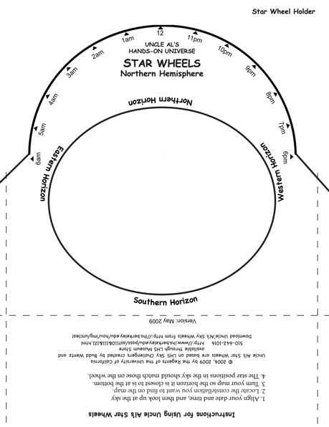
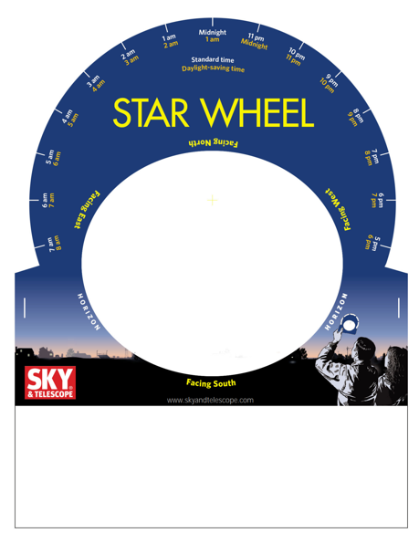
Star Wheels
Notes:
https://www.lawrencehallofscience.org/science-activities/star-wheels/
https://skyandtelescope.org/astronomy-resources/make-a-star-wheel/

Slide 15
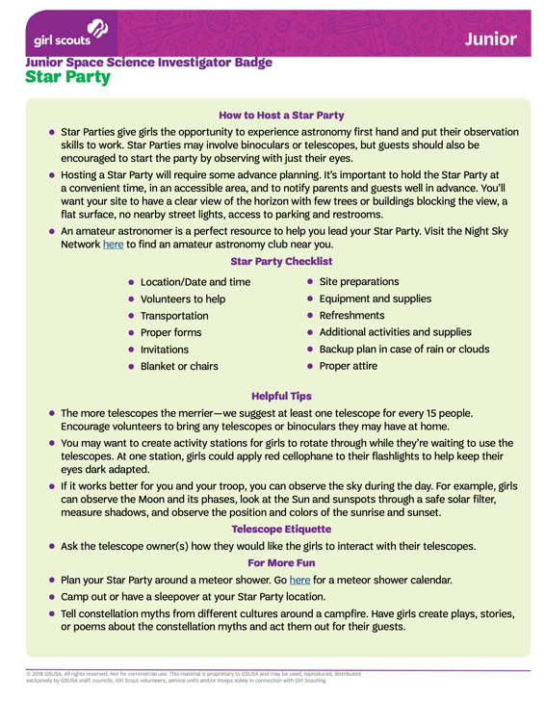
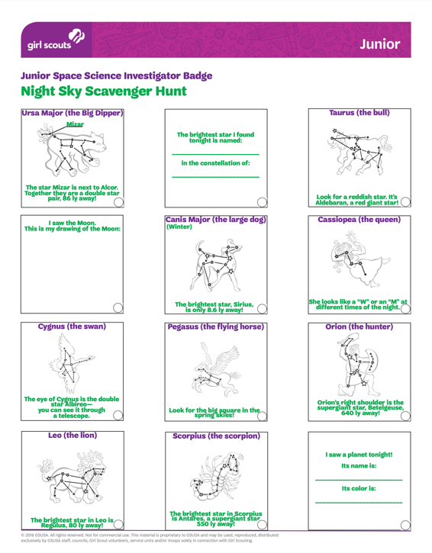
Volunteer Toolkit Resource: Star Party and Night Sky Scavenger Hunt
Notes:
https://my.girlscouts.org/content/dam/girlscouts-vtk2018/local/aid/meetings/J18NASA3/Junior-Mtg-3-Star-Party.pdf
https://my.girlscouts.org/content/dam/girlscouts-vtk/meeting-aids/Junior-Mtg-2-Night-Sky-Scavenger-Hunt.pdf

Slide 16
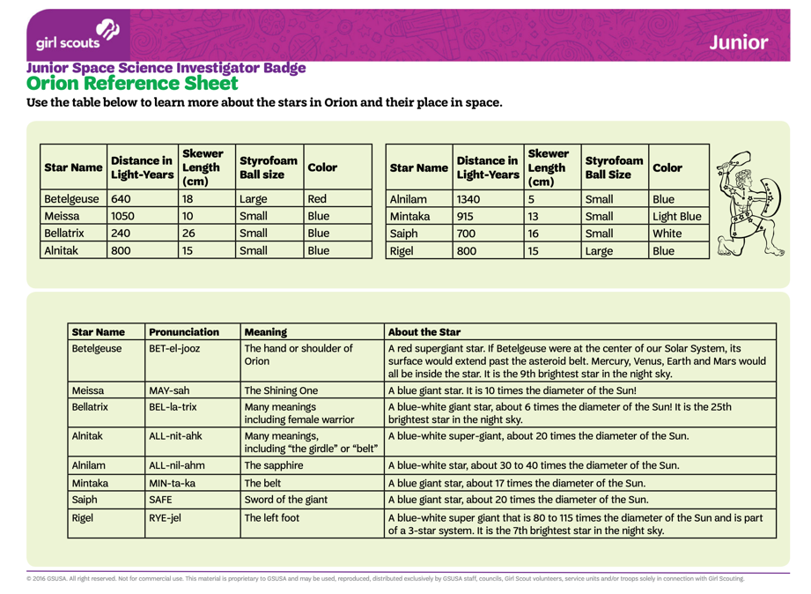
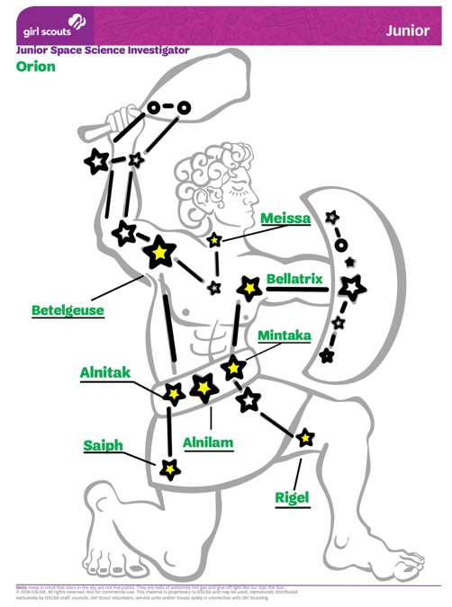
Volunteer Toolkit Resource: 3-D Constellation
Notes:
https://my.girlscouts.org/content/dam/girlscouts-vtk/meeting-aids/Junior-Mtg-2-Orion-Reference-Sheet.pdf
https://my.girlscouts.org/content/dam/girlscouts-vtk2018/local/aid/meetings/J18NASA2/Junior-Mtg-2-Orion.pdf

Slide 17
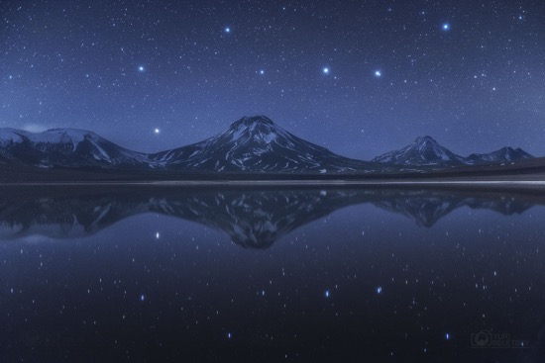
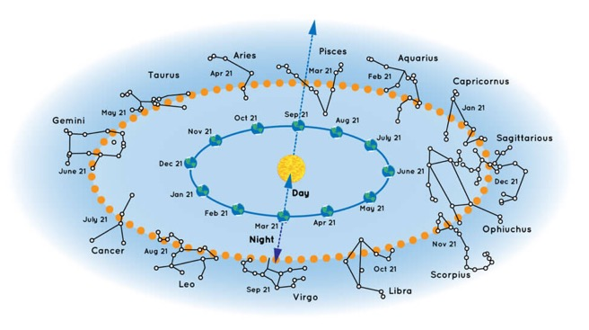
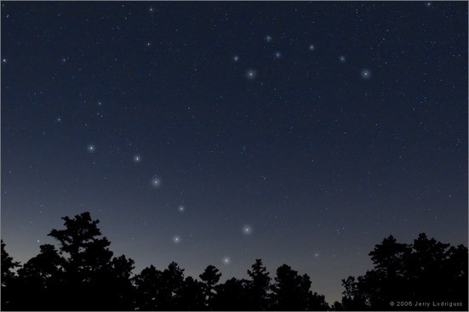
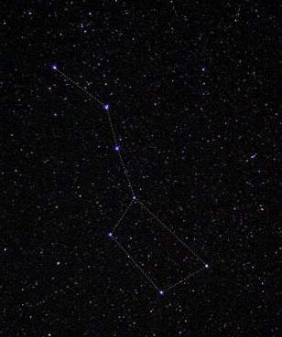
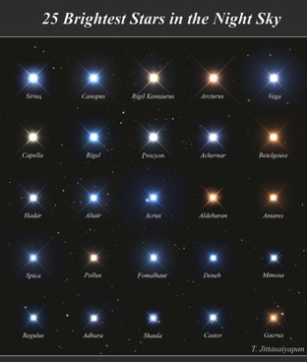
Constellation Images
Notes:
https://apod.nasa.gov/apod/ap170509.html
Big Dipper Above and Below Chilean Volcanoes Image Credit & Copyright: Yuri Beletsky (Carnegie Las Campanas Observatory, TWAN)
https://apod.nasa.gov/apod/ap130421.html
The Big Dipper Image Credit & Copyright: Jerry Lodriguss (Catching the Light)
https://spaceplace.nasa.gov/constellations/en/
https://apod.nasa.gov/apod/ap190625.html

Slide 18
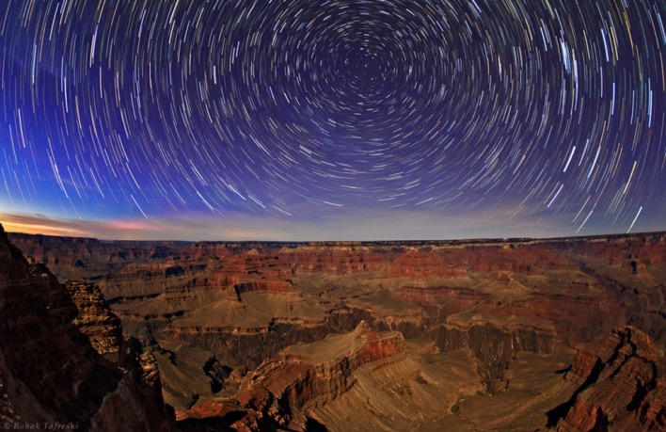
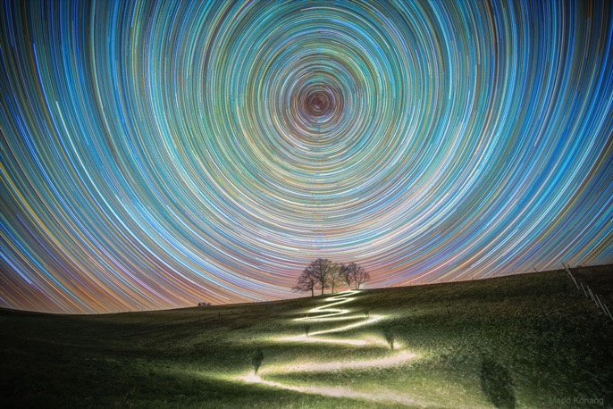
Stars over time
Notes:
https://apod.nasa.gov/apod/ap130303.html
Grand Canyon Star Trails Image Credit & Copyright: Babak Tafreshi (TWAN)
https://apod.nasa.gov/apod/ap200407.html
A Path North Image Credit & Copyright: Mario Konang

Slide 19
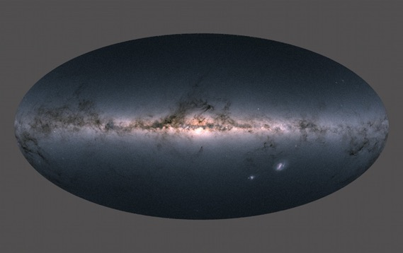
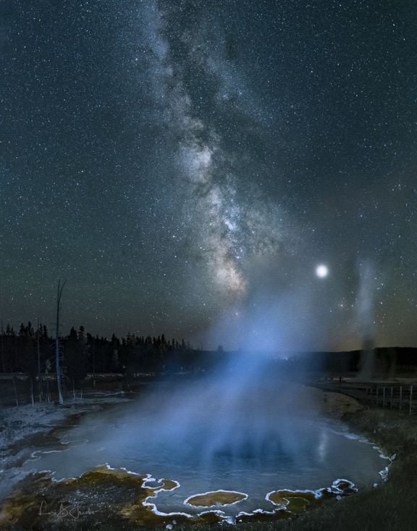
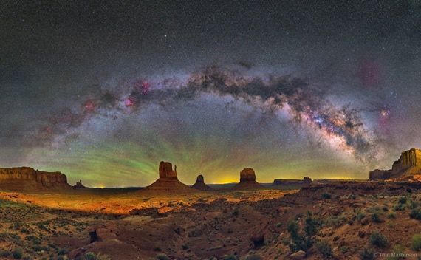
Milky Way Images
Notes:
https://apod.nasa.gov/apod/ap180427.html
Gaia's Milky Way Image Credit and Copyright: ESA, Gaia, DPAC
https://apod.nasa.gov/apod/ap170726.html
The Milky Way over Monument Valley Image Credit & Copyright: Tom Masterson
https://apod.nasa.gov/apod/ap200129.html
Milky Way over Yellowstone Image Credit & Copyright: Lori Jacobs

Slide 20
Space Exploration Use tools to explore
Space Exploration
GSUSA marks and content used with permission of the Girl Scouts of the USA
Notes:
https://www.nasa.gov/specials/moontomars/img/M2M_Gateway_Poster.pdf
Space Exploration
Junior Space Science
Just for fun slides for Daisy and Brownie Space Science.

Slide 21
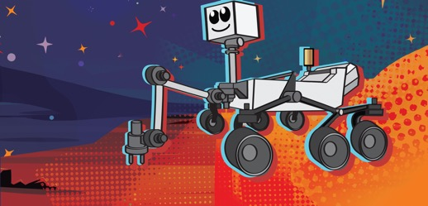
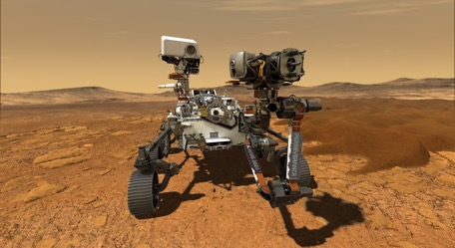
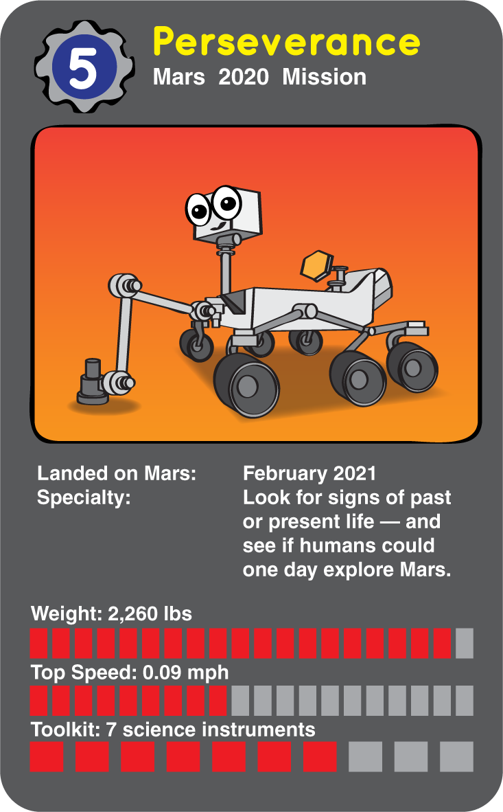
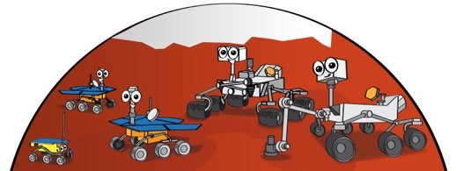
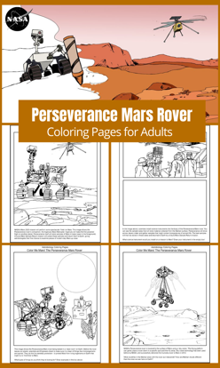
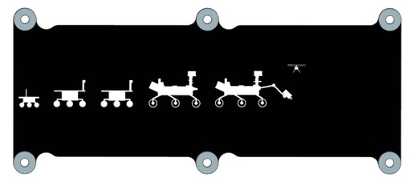
Mars Rover Images
Notes:
Mars Rover
https://spaceplace.nasa.gov/mars-rovers/en/
https://mars.nasa.gov/
https://www.jpl.nasa.gov/edu/mission-to-mars-student-challenge/
https://astrobiology.nasa.gov/resources/coloring/

Slide 22
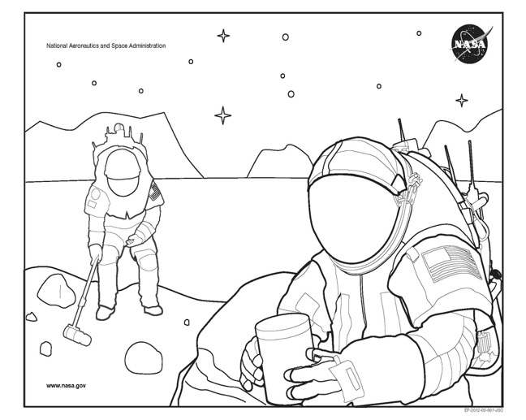
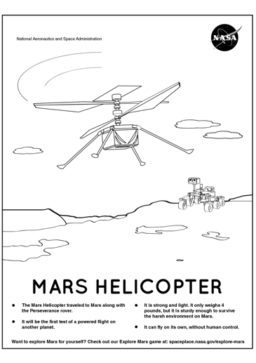
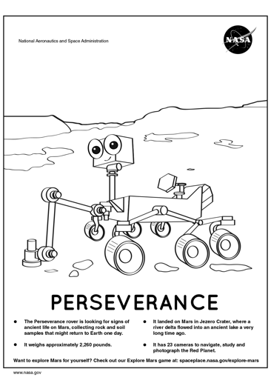
Mars Coloring Pages
Notes:
https://spaceplace.nasa.gov/coloring-pages/en/

Slide 23
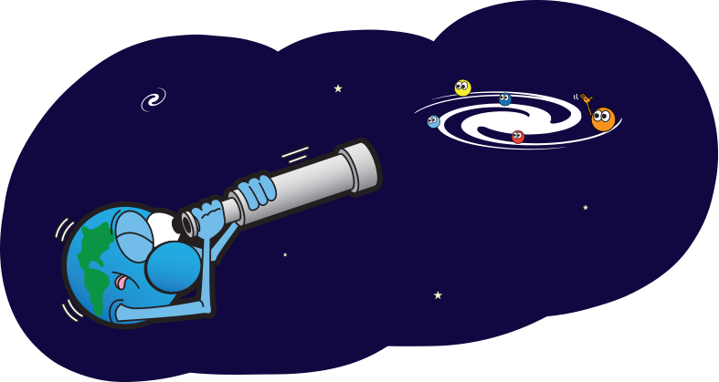
Humans in Space 1/2
I wonder
Have humans ever walked on a planet besides Earth?
Notes:
https://spaceplace.nasa.gov/glossary/en/searching-earth.en.png

Slide 24
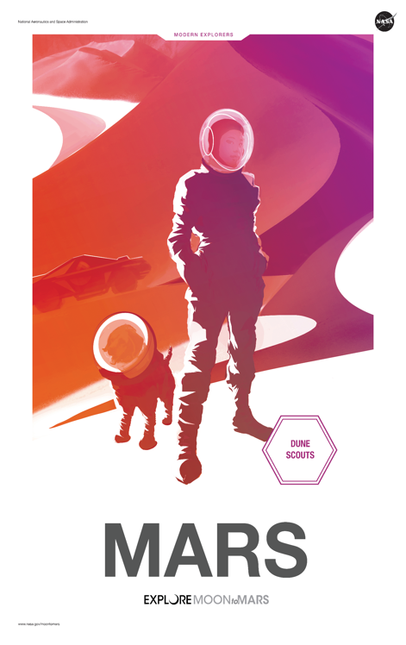
Humans in Space 2/2
Not yet! Humans have walked on the Moon, but not another planet.
NASA has spacecraft on Mars right now, and plans to send humans in the future.
Notes:
https://mars.nasa.gov/mars2020/
https://www.nasa.gov/specials/moontomars/index.html#top
https://www.nasa.gov/stem/nextgenstem/moon_to_mars/mars2020stemtoolkit
https://www.jpl.nasa.gov/edu/mission-to-mars-student-challenge/
Meet the 9 women astronauts who may be the 1st woman on the Moon
https://www.cbsnews.com/news/nasa-astronaut-artemis-program-first-woman-walk-moon-landing/

Slide 25
Meet Mae Jemison, Astronaut
Women in Space
When the space shuttle Endeavour launched into orbit in 1992, Mae became the first African-American woman to orbit the earth.
Mae looked down from the shuttle and saw Chicago. She remembered visiting the library, making science fair projects, and dancing.
"I felt like I belonged right there in space," she remembers. "I realized I would feel comfortable anywhere in the universe — because I belonged to and was a part of it, as much as any star, planet, asteroid, comet, or nebula."
Notes:
https://media.giphy.com/media/FinOFkzEPoeQ0/source.gif
SOURCE http://teacher.scholastic.com/space/mae_jemison/index.htm
Meet a Super Scientist!
Astronauts aren't born — they go to school and learn about science just like everyone else! Dr. Mae Jemison's curiosity and energy led her to learn about many things. She went to the library and dancing school. She even acted in school plays and was elected to her school government. And even though astronauts are brave, Dr. Jemison had to conquer her own feelings of fear growing up, too, as all children do.
Mae Jemison: The First Black Woman Astronaut
It was the first day of school, 1961. Five-year-old Mae Carol Jemison was a confident kindergartner who could already read. When her teacher asked her, "What do you want to be when you grow up?" Mae replied: "A scientist." Her teacher looked surprised: Not many women became scientists then, and certainly few black women. But that was Mae's first and only choice.
Mae's love for science took her to the library. She read books about the universe. She also enjoyed science fiction books. In sixth grade she read Madeline L'Engle's books A Wrinkle in Time and The Arm of the Starfish. "Those books stand out because they had women scientists and girl heroines," Mae remembers.
Books weren't the only way Mae learned. She was active in student government, acted in plays, and studied dance. "In dance class, I grew stronger and gained an appreciation for hard work, physical strength, and grace," she says.
When Mae was 12, there were civil rights demonstrations near her neighborhood in Chicago. To prevent protests before an important political meeting, the mayor of Chicago called in the National Guard, which marched through Mae's mostly African-American neighborhood with rifles. Mae watched, scared, confused, and angry. She promised herself she would never feel that frightened again. "I reminded myself that I was as much a part of this United States as the Guardsmen," she remembers.
In college, Mae studied the physical and social sciences, and learned to speak Russian and the African language Swahili. She earned a degree in chemical engineering and African studies. After college, she studied medicine for four years, and became a medical doctor.
In 1987, Mae was accepted into NASA's astronaut program. She trained in Texas, learning about space exploration. She worked for NASA, and waited for a shuttle assignment.
When the space shuttle Endeavour launched into orbit in 1992, Mae became the first African-American woman to orbit the earth. Mae looked down from the shuttle and saw Chicago. She remembered visiting the library, making science fair projects, and dancing. "I felt like I belonged right there in space," she remembers. "I realized I would feel comfortable anywhere in the universe — because I belonged to and was a part of it, as much as any star, planet, asteroid, comet, or nebula."

Slide 26
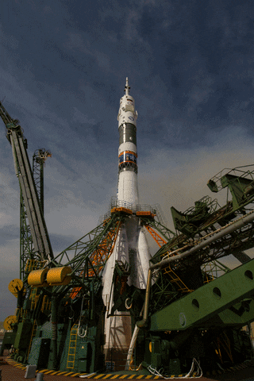
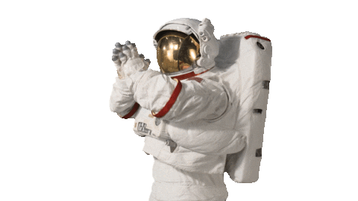
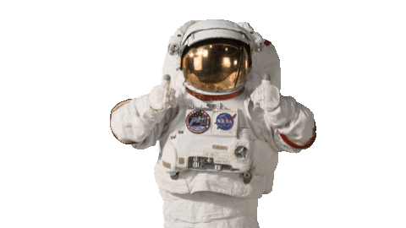
Notes:
https://giphy.com/nasa
https://giphy.com/gifs/nasa-space-fire-1n4FT4KRQkDvK0IO4X

