Slide 1
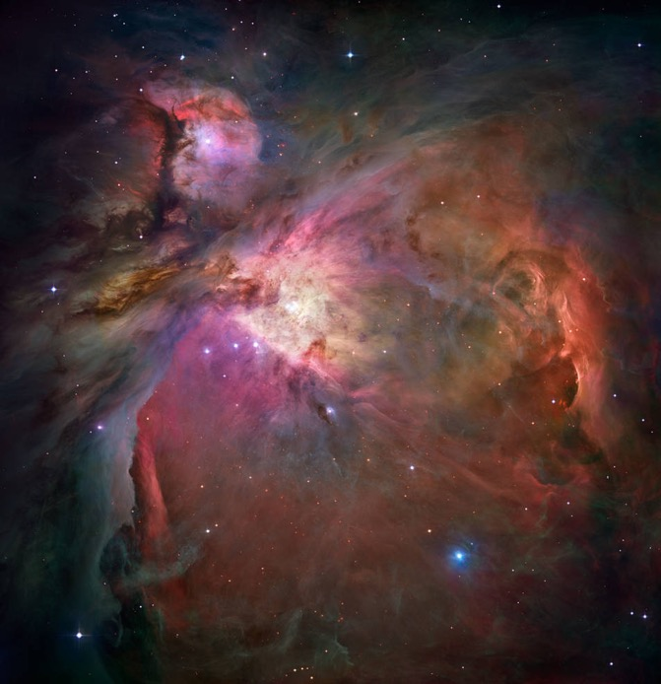



Older Girl Resources
Older Girls Grades 6-12
GSUSA marks and content used with permission of the Girl Scouts of the USA
Notes:
https://www.nasa.gov/specials/moontomars/img/M2M_Gateway_Poster.pdf
Space Exploration
Junior Space Science
For more fun slides for Daisy and Brownie Space Science.

Slide 2



Space Science for older girls
Activities
NASA STEM Engagement for grades 5-8 grade, 9-12 grade & informal educators
NASA JPL Learn
Sun,Earth, Moon and Eclipses Activity Guide
Night Sky Network - Outreach Resources
Afterschool Astronomy
Space Information and Media
www.nasa.gov
NASA Science https://science.nasa.gov/
NASA APOD - Astronomy Picture of the Day
NASA apps for smartphones
NASA social media https://www.nasa.gov/socialmedia
NASA Solar System https://solarsystem.nasa.gov/planets/overview/
NASA Missions https://science.nasa.gov/missions-page
NASA Posters: Solar System, SpacePlace, JPL Posters, NASA Missions
NASA Pictures of the Sun - from today!
NASA Internships https://intern.nasa.gov/
NASA Careers https://www.nasa.gov/careers

Slide 3
Space Science for older girls
Books
Astronomical Society of the Pacific book listing
Astrophysics for Young People in a Hurry by Neil deGrasse Tyson
A Mighty Girl’s list of Women in Space Science book list
Videos & Virtual Events
NASA Live & NASA TV
NASA Calendar of Events
Night Sky Network events & Night Sky Network YouTube
SETI Institute SETI Talks & more
Science at NASA YouTube
YouTube - search “space”, “astronomy”, “NASA”…
Astronomy Crash Course YouTube
NOVA videos

Slide 4
Night Sky Observing
What’s Up
Printable Sky Maps by month
Night Sky Network: Night Sky Planner
Interactive Sky Chart
Sky watching tips from NASA
Time & Date Astronomy: sunrise, moonrise, and more
Activities
Attend a local Night Sky Network Star Party
Senior - Nighttime Scavenger Hunt
Night Sky Network’s Celestial Treasure Hunt
Spot the International Space Station
Tools
Make a paper star wheel - Uncle Al’s or Sky & Telescope
Make a paper Moon Phase Calendar
Book: The Total Skywatcher’s Manual
Remote Telescopes
MicroObservatory (recommended)
Lists from Sky at Night remote telescopes and Insight Observatory
Skynet Junior (must be paired with adult)
Astrophotography
Girl Scout astrophotography tips
NASA: Photography Guide of the Moon

Slide 5
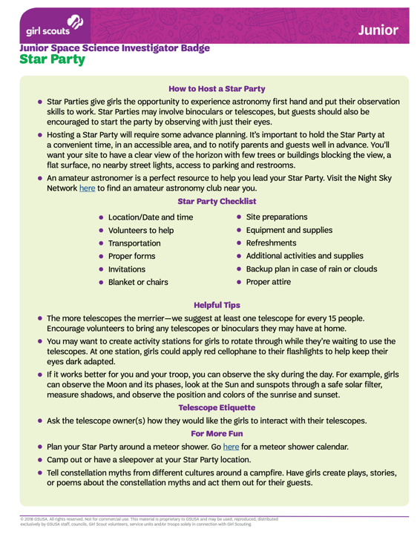
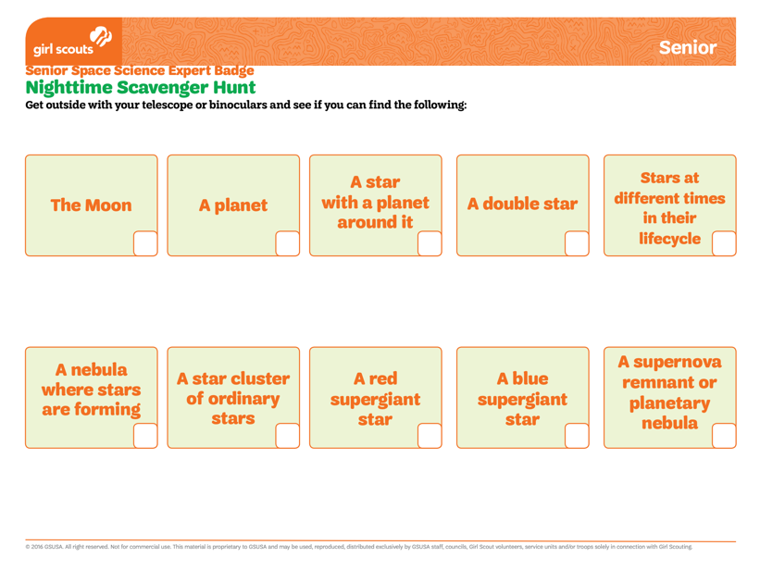
Volunteer Toolkit Resource: Night Sky Scavenger Hunt
Notes:
https://my.girlscouts.org/content/dam/girlscouts-vtk/meeting-aids/Senior%20Mtg%202%20-%20Nighttime%20Scavenger%20Hunt.pdf
https://my.girlscouts.org/content/dam/girlscouts-vtk2018/local/aid/meetings/J18NASA3/Junior-Mtg-3-Star-Party.pdf

Slide 6
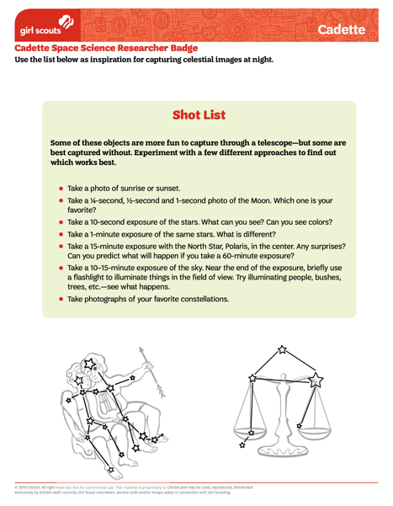
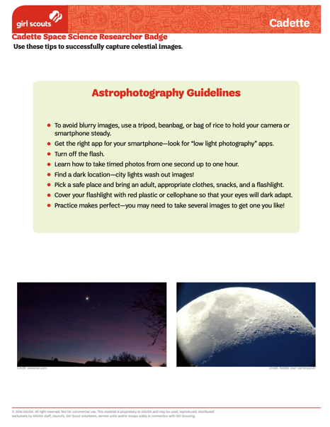
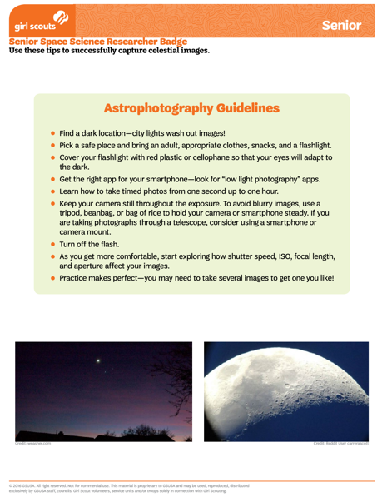
Volunteer Toolkit Resource: Astrophotography
Notes:
https://my.girlscouts.org/content/dam/girlscouts-vtk/meeting-aids/Cadette%20Mtg%203%20-%20Shot%20List.pdf
https://my.girlscouts.org/content/dam/girlscouts-vtk/meeting-aids/Cadette%20Mtg%203%20-%20Astrophotography%20Guidelines.pdf
https://my.girlscouts.org/content/dam/girlscouts-vtk/meeting-aids/Senior%20Mtg%203%20-%20Astrophotography%20Guidelines.pdf

Slide 7
Space Science:
Get Involved
Citizen Science: Conserve the
GLOBE at Night (also in SciStarter Girl Scout Journey)
Dark Sky Association
Good Night, Good Light Night Sky Network activity
Conserve the night videos:
Light Pollution 101
Dark Sky playlist
Light Pollution remix song
More Citizen Science & NASA Opportunities
NASA Citizen Science
NASA Contests & Challenges
CosmoQuest
Zooniverse
How to get started on an advanced science project

Slide 8
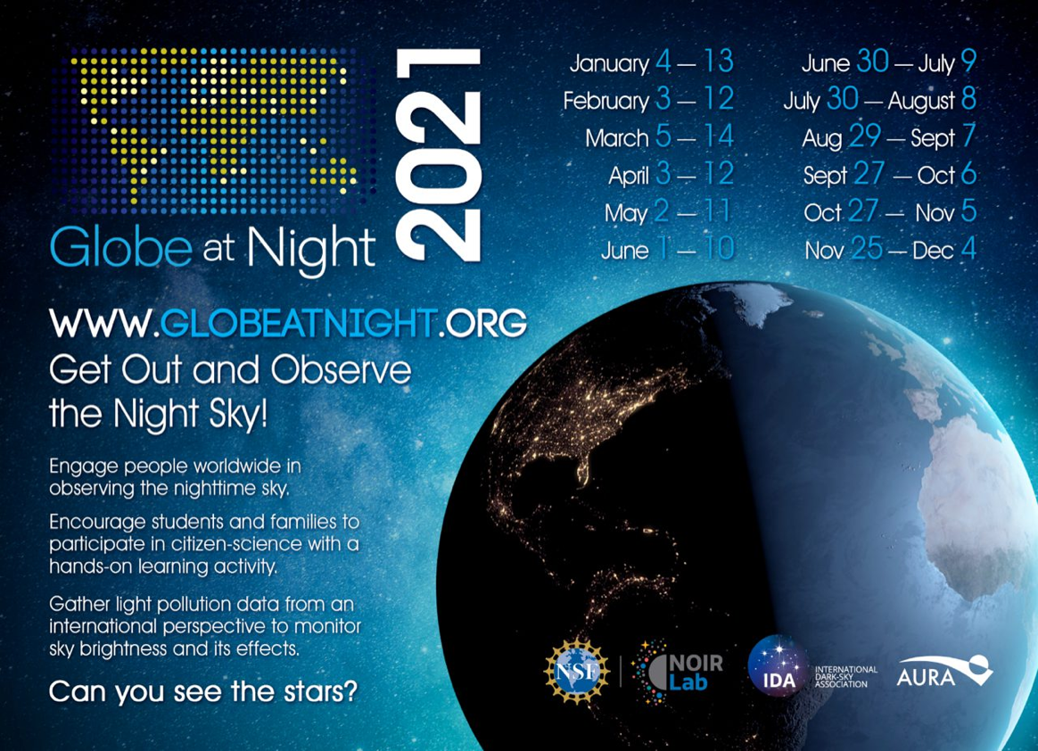
GLOBE at Night
https://www.globeatnight.org/
Notes:
https://www.globeatnight.org/

Slide 9
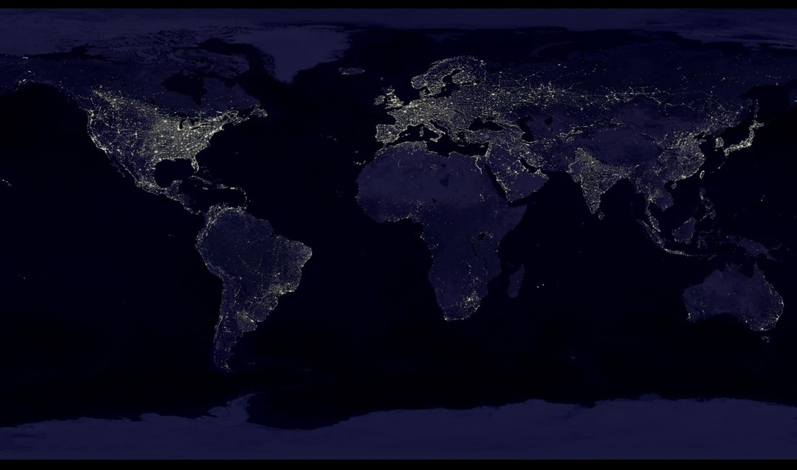
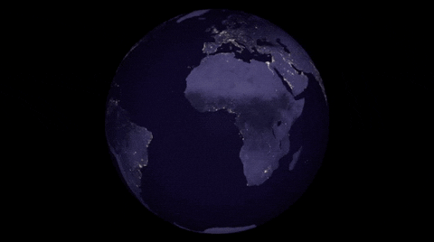
Earth at night
Notes:
https://www.globeatnight.org/
https://www.nasa.gov/sites/default/files/images/324350main_11_full.jpg
https://www.nasa.gov/topics/earth/images/index.html

Slide 10
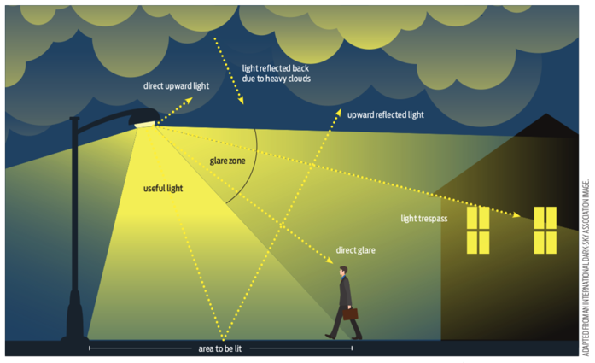
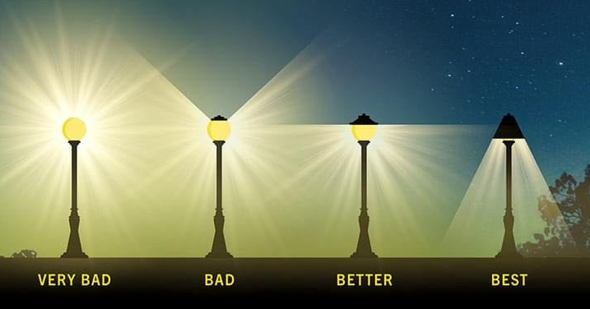
Rate a light
Notes:
https://www.darksky.org/light-pollution/
https://www.darksky.org/light-pollution/measuring-light-pollution/
https://nightsky.jpl.nasa.gov/download-view.cfm?Doc_ID=683

Slide 11
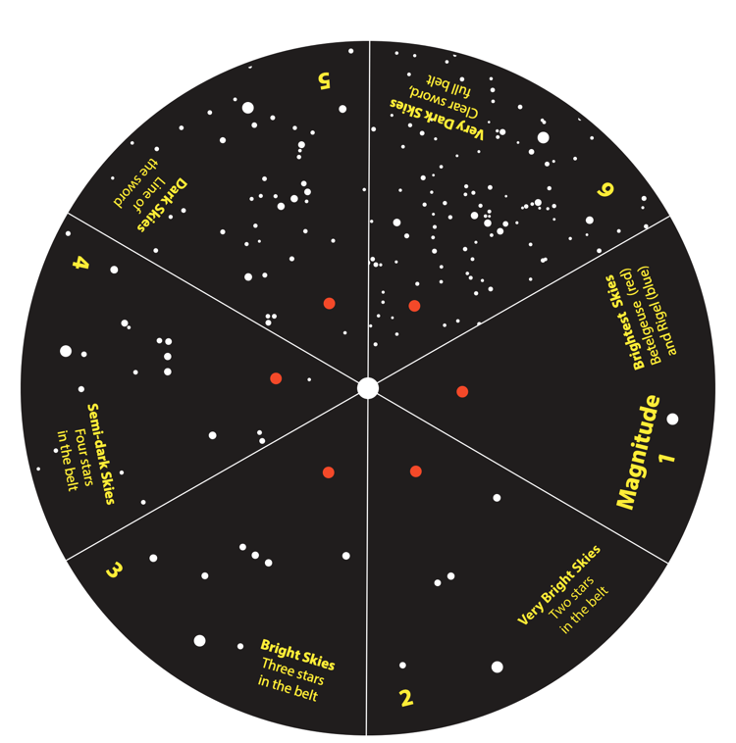
Dark Sky Wheel
How many stars can you see in Orion’s belt tonight?
© 2019 Astronomical Society of the Pacific
NASA Night Sky Network: nightskynetwork.org
Notes:
https://nightsky.jpl.nasa.gov/download-view.cfm?Doc_ID=683

Slide 12
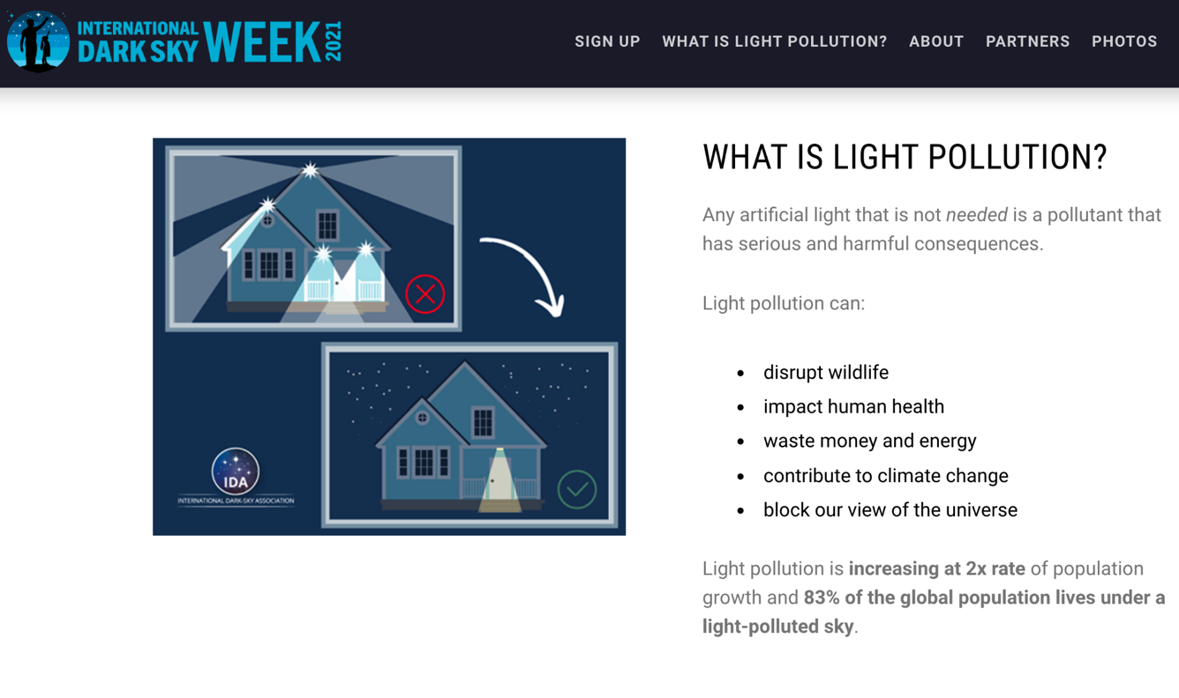
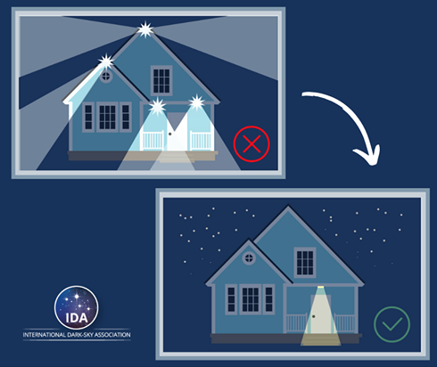
Notes:
https://www.darksky.org/light-pollution/
https://www.globeatnight.org/

Slide 13

Electromagnetic Spectrum
(EMS)
EMS Overview
NASA Science https://science.nasa.gov/ems/
California Academy of Sciences Video: Learning from Light
Alma Kids Video: Electromagnetic Spectrum
Crash Course Video: Stars & Video: Light is Waves
Online Interactives & Activities
Interactive: National Radio Astronomy Observatory Cosmic Coloring
Interactive: ViewSpace explore from different perspectives
Interactive: Clues to the Cosmos - use with this
Activity: Color Spinner (GS at Home Cadette step)
Activity: Cadette “More Than The Eye Can See” help
Books & Posters
EMS NASA Poster
EMS Comic Book
Videos
How rainbows form
Learning from light
How do space telescopes break down light?
Three women who changed how we see the universe

Slide 14
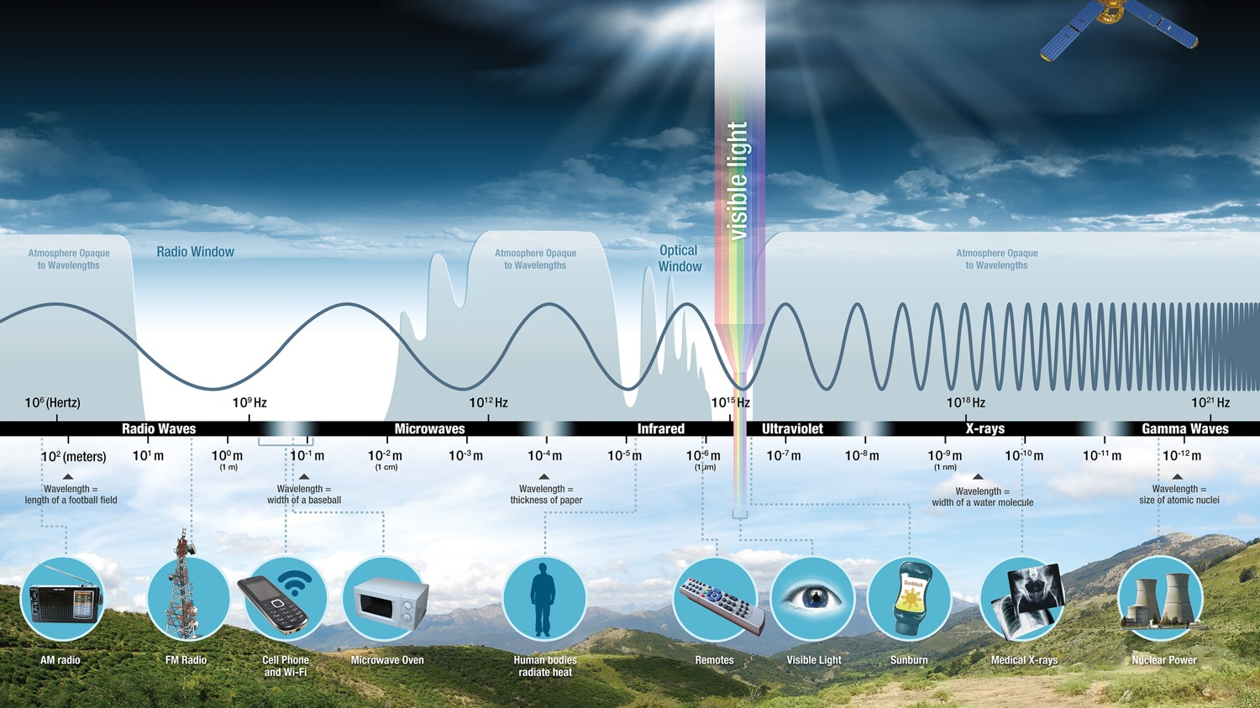
NASA Electromagnetic Spectrum Poster
Notes:
https://smd-prod.s3.amazonaws.com/science-pink/s3fs-public/thumbnails/image/EMS-Introduction_0.jpeg
https://science.nasa.gov/ems/01_intro

Slide 15
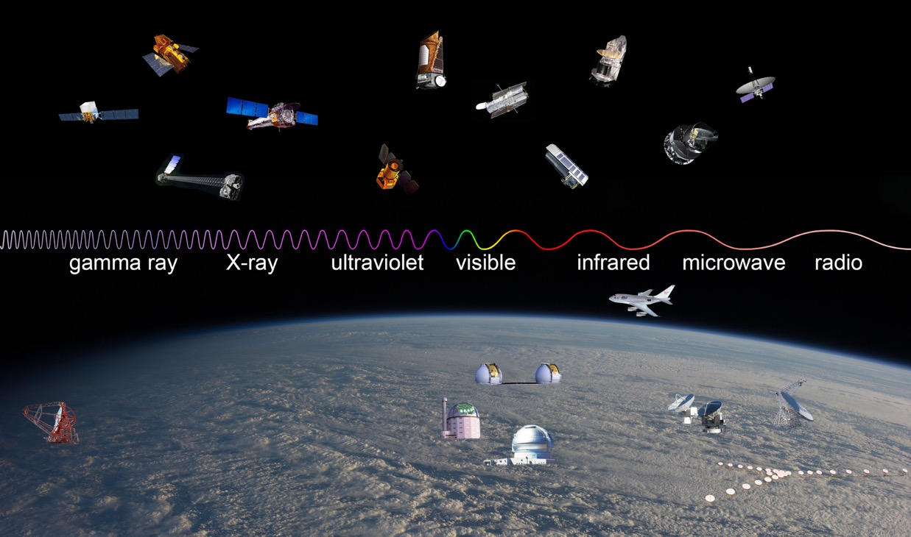
Observatories Across the Spectrum
Notes:
https://imagine.gsfc.nasa.gov/Images/science/observatories_across_spectrum_full.jpg

Slide 16
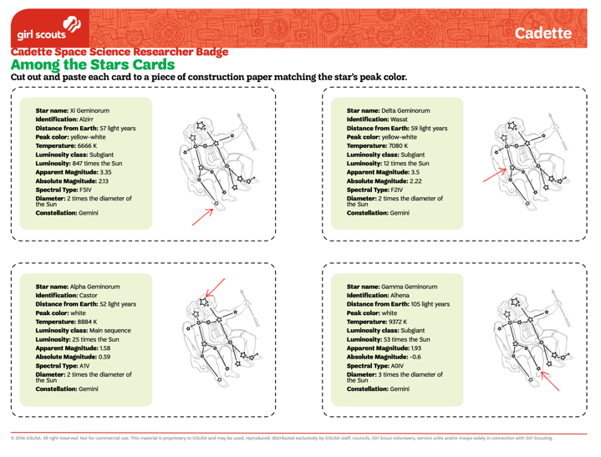
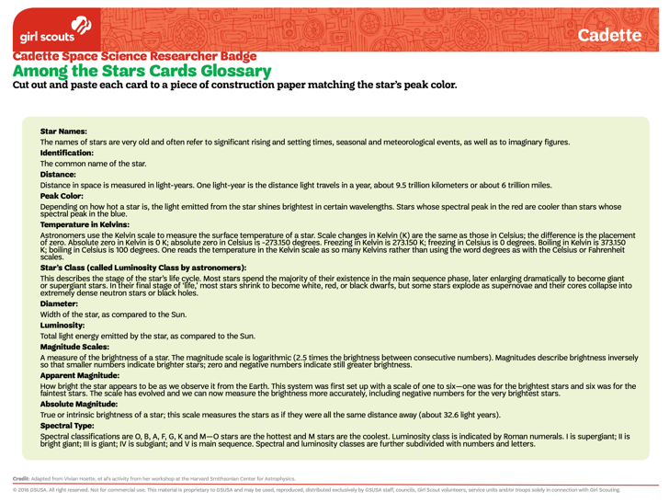
Volunteer Toolkit Resource: Among the Stars Cards
Notes:
https://my.girlscouts.org/content/dam/girlscouts-vtk/meeting-aids/Cadette%20Mtg%203%20-%20Among%20the%20Stars%20Cards.pdf

Slide 17
Stellar Evolution
Information
NASA Science How Stars Form and Evolve
NASA Goddard stellar evolution
Stardust Self Portrait
  Stardust Self Portrait (GS at Home Senior step)
  https://www.nhm.ac.uk/discover/are-we-really-made-of-stardust.html
  Infographic examples https://www.jpl.nasa.gov/infographics/
Activities
Scrapbook the Lives of Stars activity sheet
NSN Universe without Supernovae & GS Universe without Supernovae
Jamboard - Sorting the Sky
Play a Game: Girl Scout Photo cards & Information cards
Videos
NASA Launchpad: Lifecycle of a Star
NASA | Afterschool Universe: Life Cycle of a Small Star

Slide 18
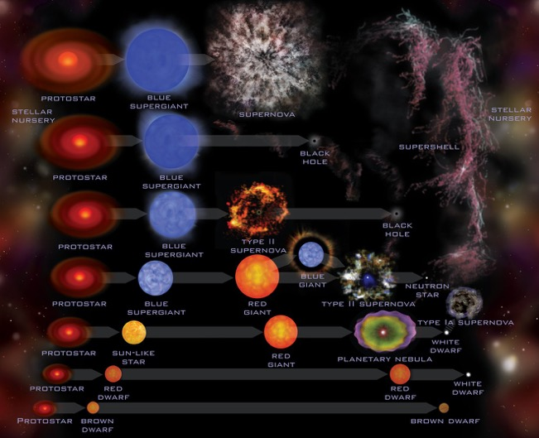
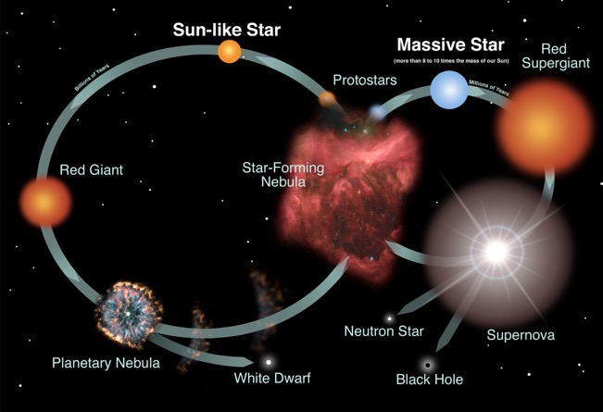
NASA Stellar Evolution
Notes:
https://www.jpl.nasa.gov/infographics/stellar-evolution
https://d2pn8kiwq2w21t.cloudfront.net/images/infographicsuploadsinfographicsfull10737.width-1320.jpg
https://imagine.gsfc.nasa.gov/Images/objects/stars_lifecycle_full.jpg
https://imagine.gsfc.nasa.gov/educators/lifecycles/stars.html

Slide 19
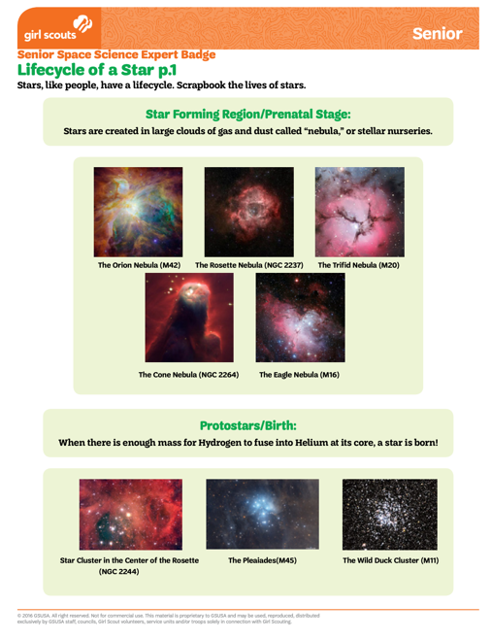
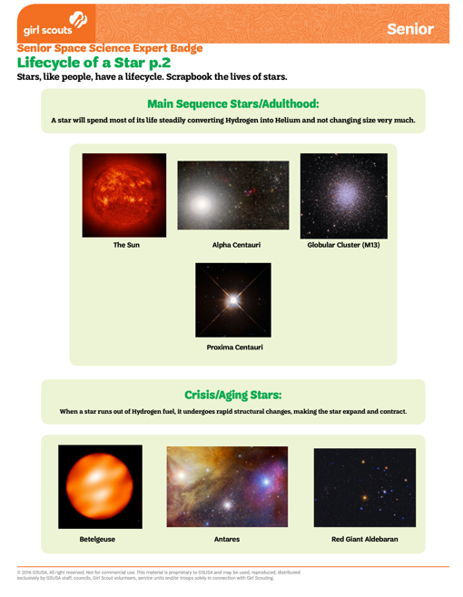
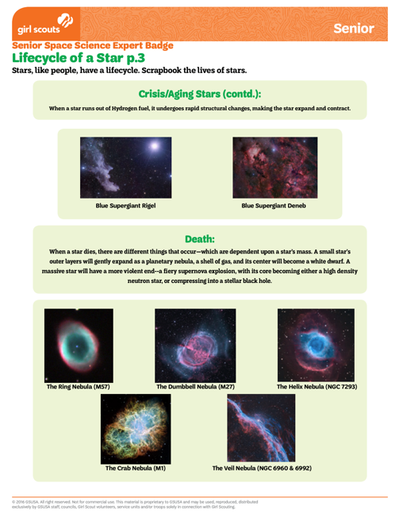
Volunteer Toolkit Resource: Lifecycle of a Star
Notes:
https://my.girlscouts.org/content/dam/girlscouts-vtk/meeting-aids/Senior%20Mtg%202%20-%20Lifecycle%20of%20a%20Star.pdf

Slide 20
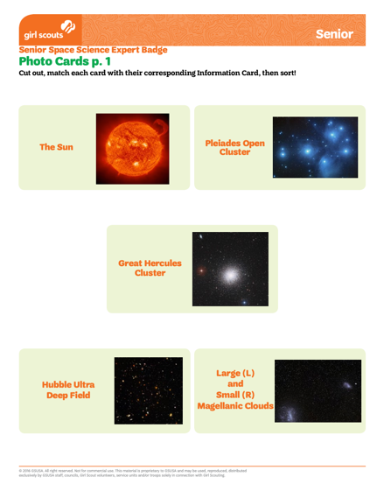
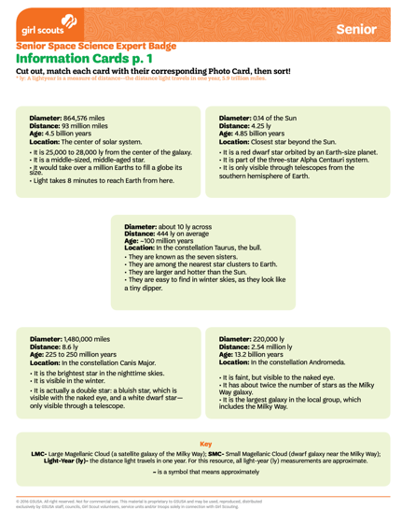
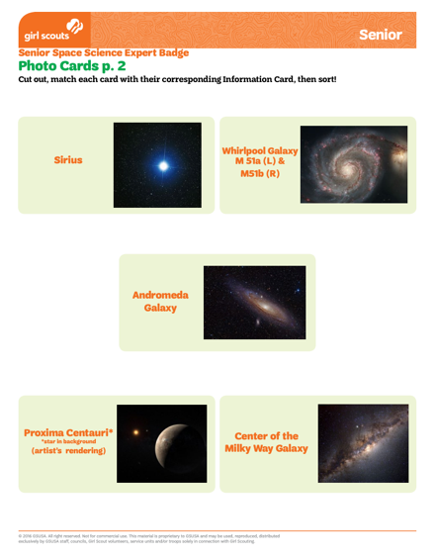
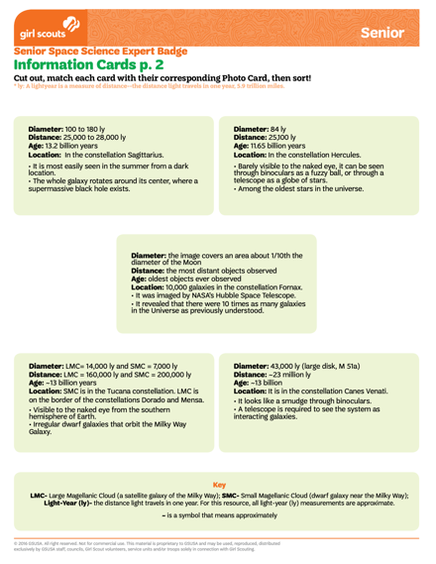
Volunteer Toolkit Resource: Photo & Information Cards
Notes:
https://my.girlscouts.org/content/dam/girlscouts-vtk/meeting-aids/Senior%20Mtg%202%20-%20Photo%20Cards%20V2.pdf
https://my.girlscouts.org/content/dam/girlscouts-vtk/meeting-aids/Senior%20Mtg%202%20-%20Information%20Cards.pdf

Slide 21
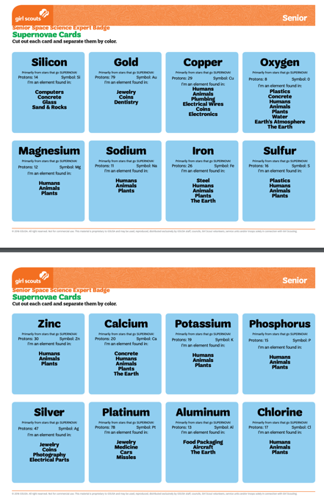
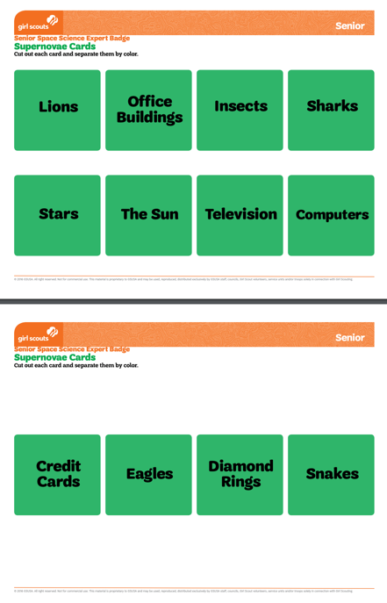
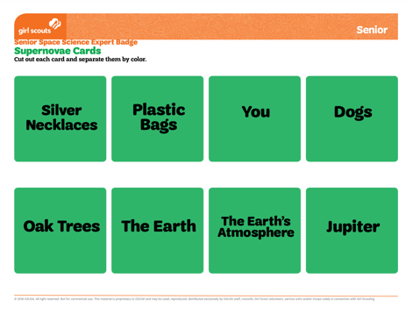
Volunteer Toolkit Resource: Supernovae Cards
Notes:
https://my.girlscouts.org/content/dam/girlscouts-vtk/meeting-aids/Senior%20-%20Supernovae%20Cards.pdf

Slide 22
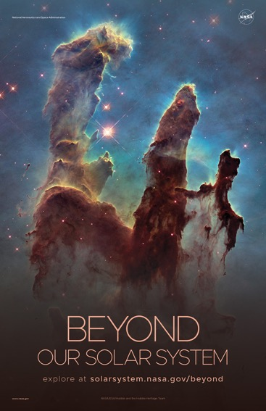
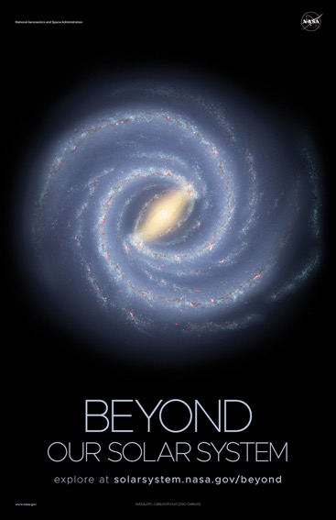
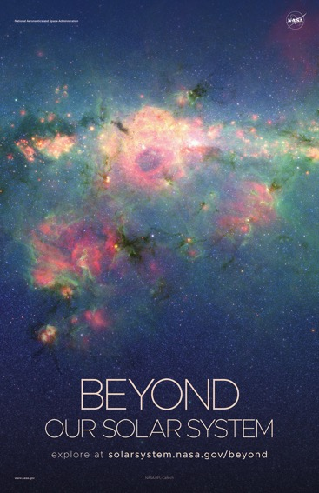
NASA “Beyond” Posters
Notes:
https://solarsystem.nasa.gov/resources/940/beyond-our-solar-system-poster-version-c/

Slide 23
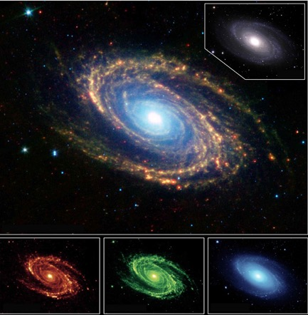
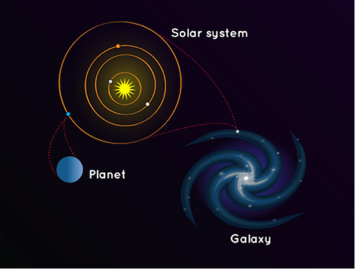
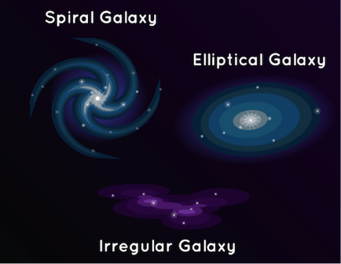
Galaxies
Notes:
https://www.jpl.nasa.gov/spaceimages/images/largesize/PIA04937_hires.jpg
https://spaceplace.nasa.gov/galaxy/en/

Slide 24
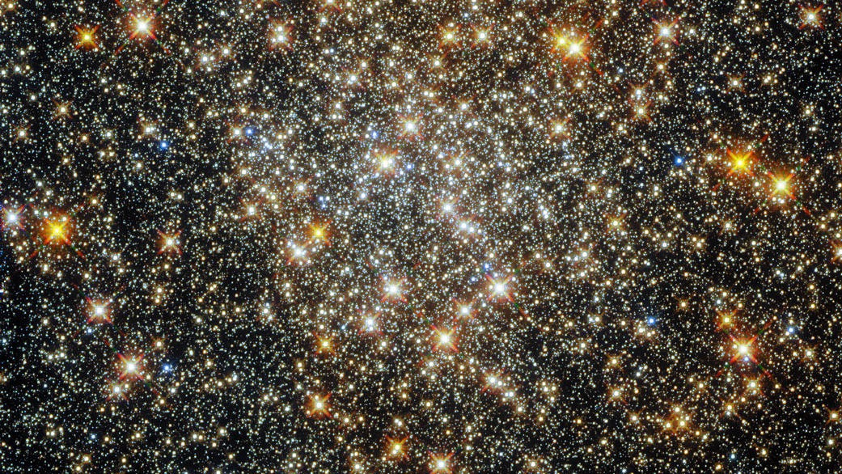
Notes:
https://www.nasa.gov/image-feature/goddard/2021/hubble-captures-a-cluster-in-the-heart-of-the-milky-way

Slide 25
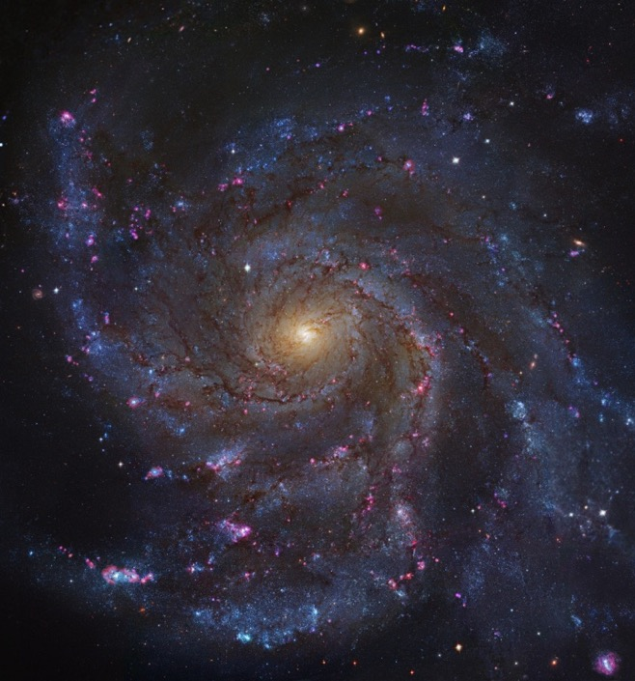
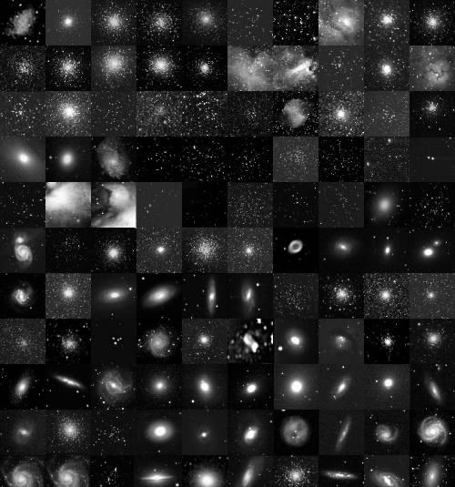
Deep Space Object Images
Notes:
https://apod.nasa.gov/apod/ap110415.html
https://apod.nasa.gov/apod/ap000311.html

Slide 26

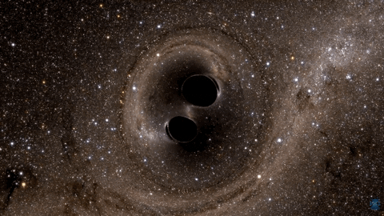
Black Hole GIFs
Notes:
https://media0.giphy.com/media/QHJoRy2qzV5XAHWGrZ/giphy.gif?cid=5e214886c71602c9894421405555f2d51e670b64824231a7&rid=giphy.gif&ct=g
https://giphy.com/gifs/nasa-space-nasagif-xT9IgoYWAh5lYliiYM

Slide 27

Worlds Beyond Earth
Information
NASA Exoplanets
NASA Beyond Our Solar System
Activities
Small Worlds Game
GSUSA Edition of Infiniscope Interactive (how to play)
Design a Habitat for an Alien World
GS at Home Ambassador step
NASA Eyes on Exoplanets
NASA Exoplanet Citizen Science

Slide 28
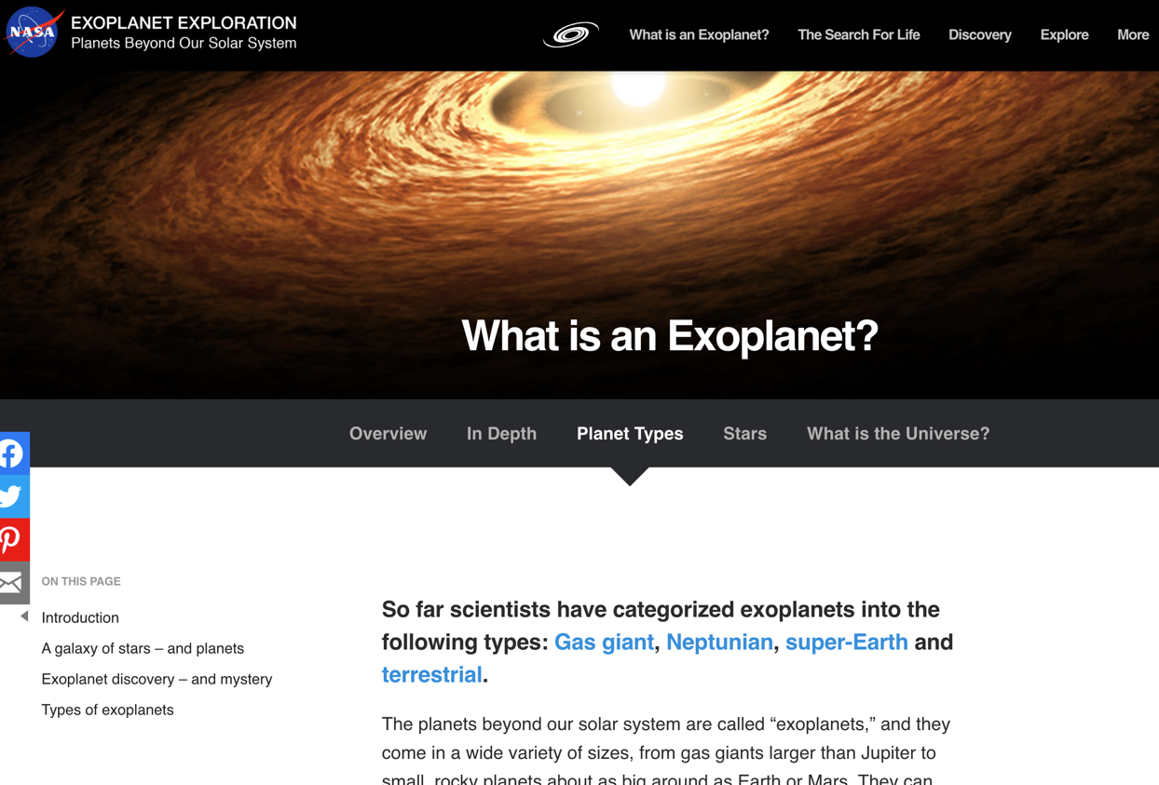
Notes:
https://exoplanets.nasa.gov/what-is-an-exoplanet/planet-types/overview/

Slide 29
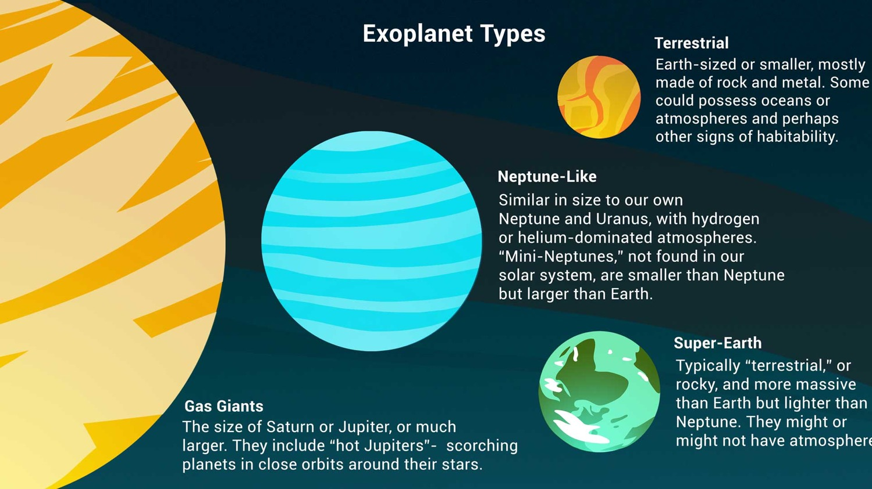
Notes:
https://exoplanets.nasa.gov/
Variety is a major theme in exoplanet discoveries over the past quarter century, as shown in this illustration. Most have been discovered by the "transit" method – watching for the tiniest of shadows as a planet crosses the face of its star. Credit: NASA/JPL-Caltech

Slide 30
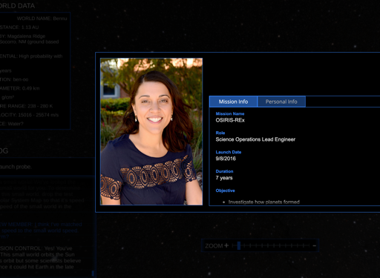
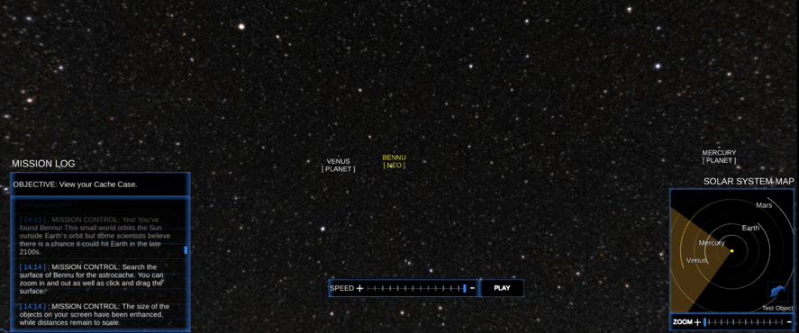
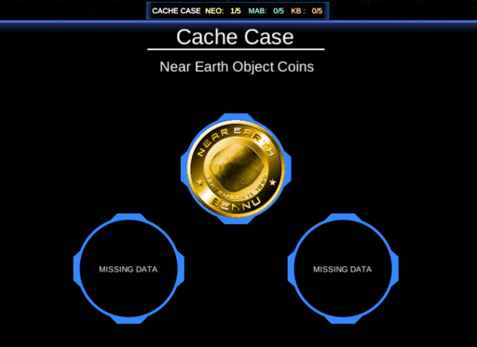

Small Worlds Interactive for Girl Scouts
Small Worlds (Exoplanets) Interactive
Notes:
https://www.girlscouts.org/SpaceScienceSmallWorlds
Your mission is to step into the shoes of an astronomer as you seek out and locate 15 small worlds in our solar system. Of the unknown number of small worlds in our solar system, unlock all 15 by first finding three in each “zone,” search for their hidden treasure, and discover significant scientific contributions from women in STEM fields.

Slide 31
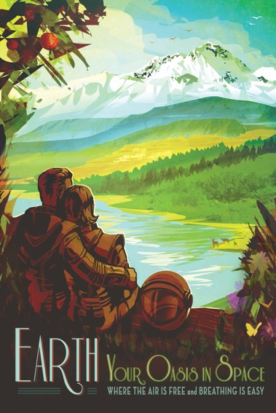
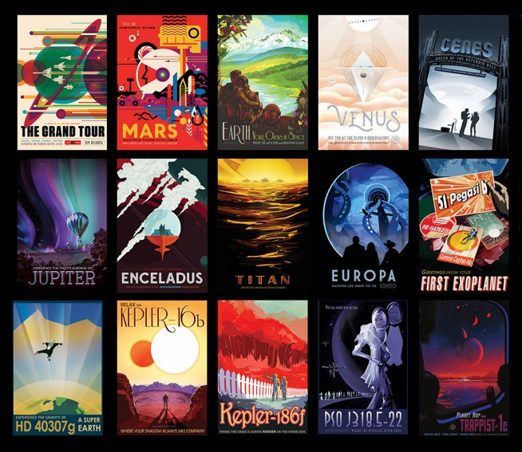
NASA Space Tourism Posters
Notes:
https://solarsystem.nasa.gov/resources/682/space-tourism-posters/
https://www.jpl.nasa.gov/galleries/visions-of-the-future

Slide 32
Women in Space
Girl Scouts Women in Science links list PDF
Women at NASA Bios
  https://women.nasa.gov/
  https://www.nasa.gov/women
Women in Space - posters
Women in Space - history
Movie: Hidden Figures
Play: Silent Sky
Series: Cosmos Sisters of the Sun episode
Series: Makers: Women in Space
Movie: Mercury 13

Slide 33
Space Science
Careers
NASA: https://nasajobs.nasa.gov/
NASA Internships https://intern.nasa.gov/
Careers https://www.nasa.gov/stem/womenstem.html
American Astronomical Society Planning Your Education
“A New Universe to Explore: Careers in Astronomy,” an AAS Committee on the Status of Women in Astronomy: https://cswa.aas.org
Women in Aerospace: http://www.womeninaerospace.org
Society of Women Engineers: http://societyofwomenengineers.swe.org
MAES: Latinos in Science and Engineering: http://mymaes.org
National Society of Black Physicists: http://nsbp.org
National Society of Black Engineers: http://www.nsbe.org
American Indian Science and Engineering Society: http://www.aises.org
Division of Planetary Sciences: Graduate Schools
These schools also offer exceptional undergraduate courses of study.
American Geophysical Union “Paths Through Science”
Explore the AGU Blogosphere
IEEE: Institute of Electrical and Electronics Engineers: http://tryengineering.org/university
American Institute of Aeronautics and Astronautics
AIAA Careers in Aerospace

